Slide 1
No energy transition without transmission
Rob Gramlich
HEPG 3/14/23

Slide 2
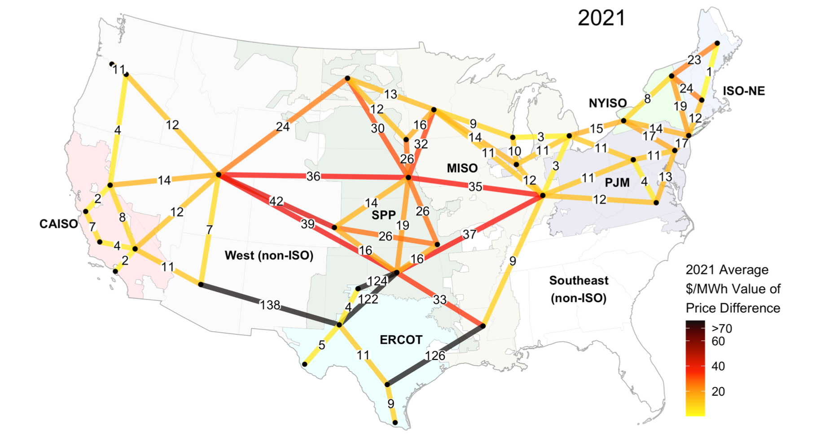
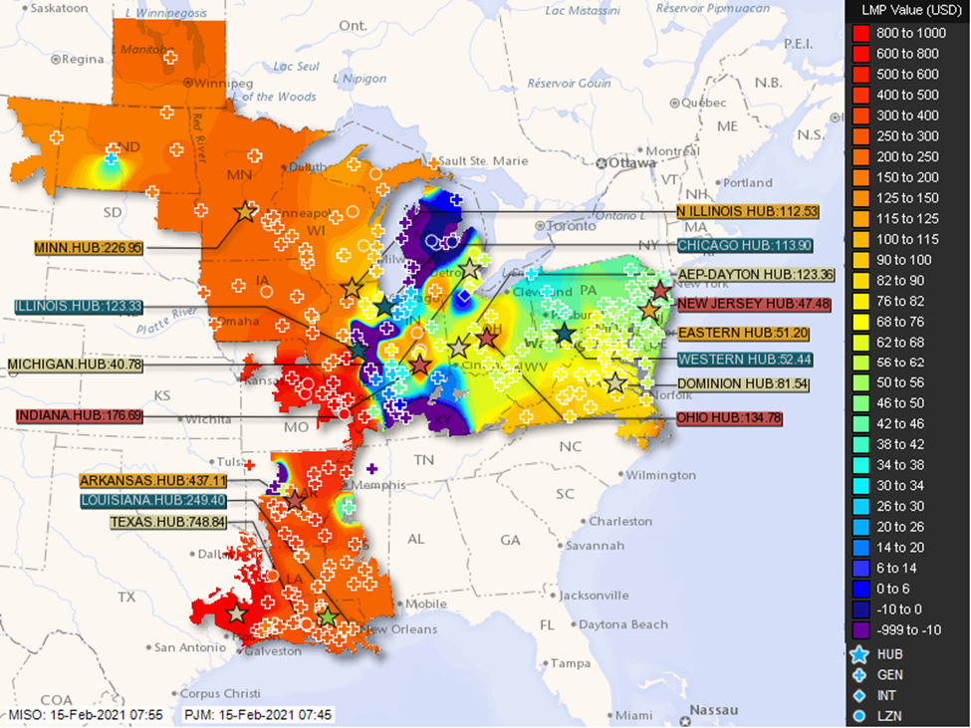
Under-appreciated benefits of transmission
Reliability/resilience
Capacity value
50% of value in 5% of hours (LBNL)
Flows in both directions (winter storms Elliot, Uri, etc)
Higher ELCC with regionally diverse portfolio
Wind/hydro/geothermal/solar/storage complementarity
Congestion
Production cost modeling always under-forecasts congestion, by a lot.
LBNL

Slide 3
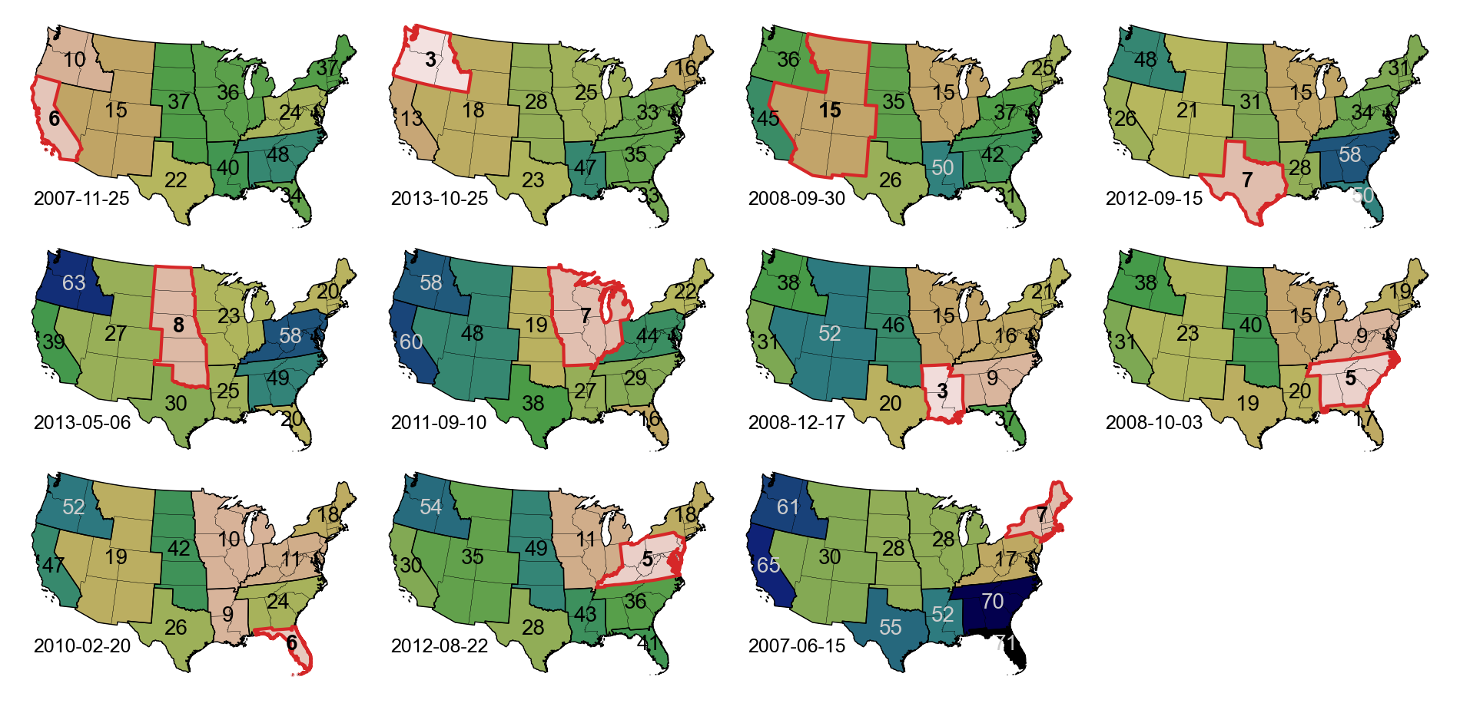
Windy next door if not here
Take the least-windy day in each planning area from 2007–2013.
How windy are each of the other planning areas on that day?
Single-day wind capacity factor [%] at top quintile of sites
(Patrick Brown, MIT, NREL)

Slide 4
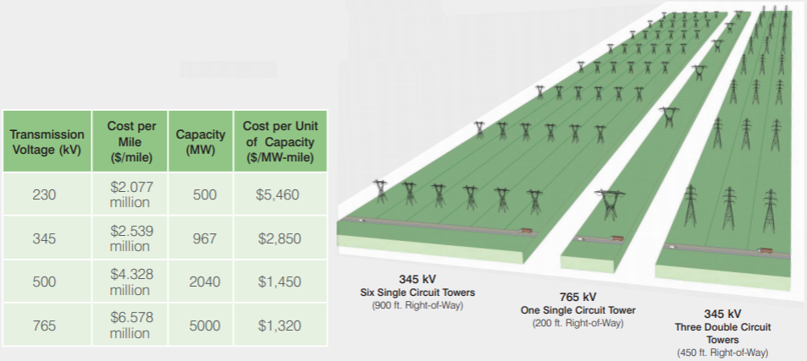
Under-appreciated declining transmission cost—Bigger uses less $ and land
Transmission Voltage (kV) | Cost per Mile ($/mile) | Capacity (MW) | Cost per Unit of Capacity ($/MW-Mile)
230 | $2.047 million | 657 | $3,115
345 | $3.273 million | 1792 | $1,827
500 | $4.080 million | 2598 | $1,574
765 | $5.120 million | 6625 | $773
(1,050 ft. Right-of-Way)
(225 ft. Right-of-Way)
(525 ft. Right-of-Way)
p. 37, 39, 45 https://cdn.misoenergy.org/20220208%20PSC%20Item%2005c%20Transmission%20Cost%20Estimation%20Guide%20for%20MTEP22_Draft622733.pdf

Slide 5
117th Congress hit a bunt or two but no home run
IIJA/Bipartisan Infrastructure Law
Siting of Interstate Electric Transmission Facilities (Sec. 40105)
Strengthened FERC’s backstop siting authority ​
Transmission Facilitation Program (Sec. 40106)
$2.5 billion revolving loan fund for DOE to serve as an anchor tenant
Inflation Reduction Act
Transmission Facility Financing (Sec. 50151)​ ($2 billion in direct loans)
Grants to Facilitate the Siting of Interstate Electricity Lines (Sec. 50152)​ ($760 million in grants)
Interreg. and Offshore Wind Elec. Tx Planning, Modeling, and Analysis (Sec. 50153)​ ($100 m)
Funding for Department of Energy Loan Program Office (Title V Part 4 Sec. 50141)​​($3.6 billion)

Slide 6
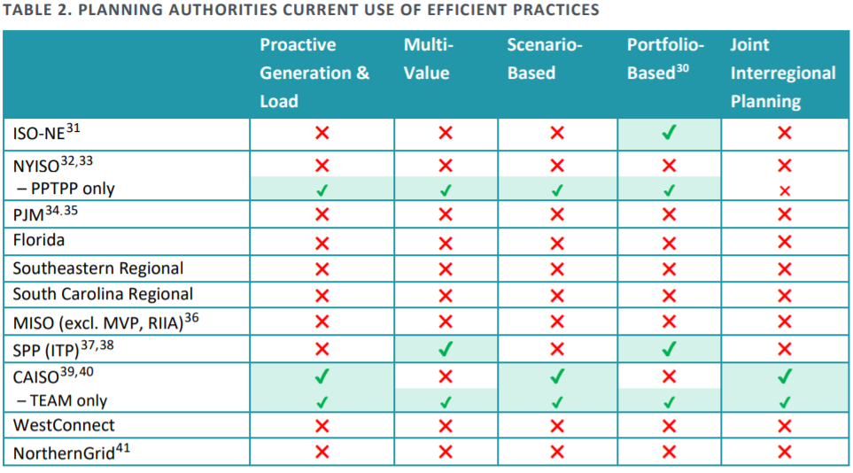
Impotent planning
Brattle, Grid Strategies: https://www.brattle.com/insights-events/publications/transmission-planning-for-the-21st-century-proven-practices-that-increase-value-and-reduce-costs/

Slide 7
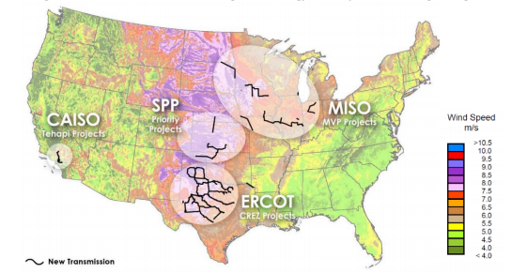
Big transmission CAN be built! Address the 3Ps
Planning
Proactive, all electricity system benefits, probabilistic/scenario based, portfolio of network upgrades, all technology options
Permitting
FERC authority
NEPA implementation—DOE lead agency, timelines, accountability
Paying
Broad beneficiary pays

Slide 8
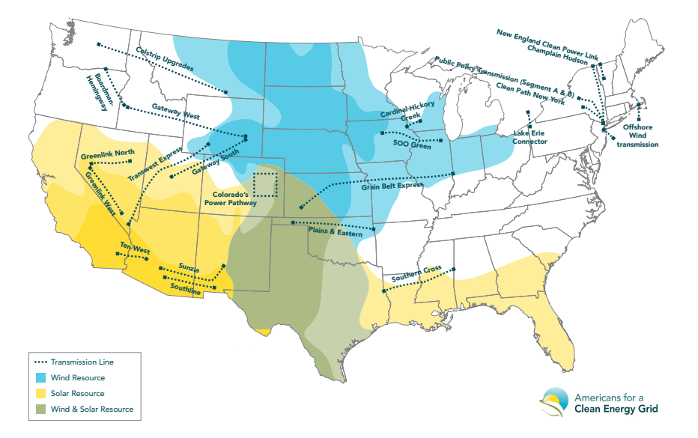
22 Projects Ready to Go
As of March 2021

Slide 9
HVDC Transmission Projects in Development
Project Name | Region | Expected Year of In-Service | Estimated Cost of Project | Capacity (MW) | Length (miles)
Empire State Connector | NY | 2023 | $1.5 billion | 1000 | 265
Champlain Hudson | NY | 2026 | $2.2 billion | 1000 | 330
New England Clean Energy Connect | New England | 2024 | $950 million | 1200 | 145
New England Clean Power Link | New England |  | $1.6 billion | 1000 | 150
Southern Spirit | SE and TX | 2028 | $2.5 billion | 2000 | 400
SOO Green | MISO & PJM | 2027 | $2.5 billion | 2100 | 349
Grain Belt Express | MISO & PJM | 2027 | $2.3 billion | 4000 | 780
Plains and Eastern Clean Line | SPP | 2027 | $2 billion | 4000 | 725
Transwest Express | CAISO | 2026 | $3 billion | 3000 | 730
North Plains Connector | West, SPP, MISO | 2029 | $2.5 billion | 3000 | 385
Three Corners Connector | West, ERCOT, SPP | 2028 | $1.5 billion |  | 300
SunZia | Southwest | 2025 | $8 billion | 3000 | 550
SouthCoast Wind (formerly Mayflower Wind) | New England | 2028 | $830 million | 1200
Sunrise Wind | NY | 2025 | $408 million | 924 | 25
NJ OSW Wind | PJM | 2030 | $504 million | 3550
Clean Path New York | NY | 2027 | $3.5 billion | 1300 | 175

Slide 10
HVAC Transmission Projects in Development
Project Name | Region | Expected Year of In-Service | Estimated Cost of Project | Capacity (MW) | Length (miles)
Cardinal-Hickory Creek | PJM |  | $520 million | 1200 | 100
SWIP North | West | 2024 | $1.5 billion | 2200 | 275
Greenlink North | West | 2027 | $810 million | 2500 | 235
Greenlink West | West | 2026 | $1.61 billion | 2500 | 351
Gateway South | West | 2024 | $1.9 billion | 1500 | 400
Gateway West | West | 2030 | $2.88 billion | 1500 | 1000
Boardman to Hemingway | Northwest | 2026 | $1.2 billion | 1000 | 300
Smart Path Connect | NY | 2025 | $380 million | 1000 | 100
R Project – Gentleman Station to Holt County | SPP |  | $330 million | 1800 | 225
Southline | Southwest | 2027 | $800 million | 1000 | 280
Rio Sol | Southwest | 2028 | $1.3 billion | 1500 | 550
Colorado’s Power Pathway | Southwest | 2027 | $1.7 billion | 3000 | 560

Slide 11
HVAC Offshore Wind Transmission Projects
Project Name | Region | Expected Year of In-Service | Estimated Cost of Project | Capacity (MW) | Length (miles)
Revolution Wind | New England | 2025 | $490 million | 704 | 42
Commonwealth Wind | New England | 2028 | $850 million | 1232 | 75
Park City Wind | New England | 2025 | $560 million | 800 | 60
Empire Wind 1 | NY | 2026 | $570 million | 816 | 46
Empire Wind 2 | NY | 2027 | $830 million | 1260 | 35
Coastal Virginia Offshore Wind | PJM | 2026 | $1.83 billion | 2640 | 71
Kitty Hawk Wind | PJM | 2027 | $550 million | 800 | 55

Slide 12
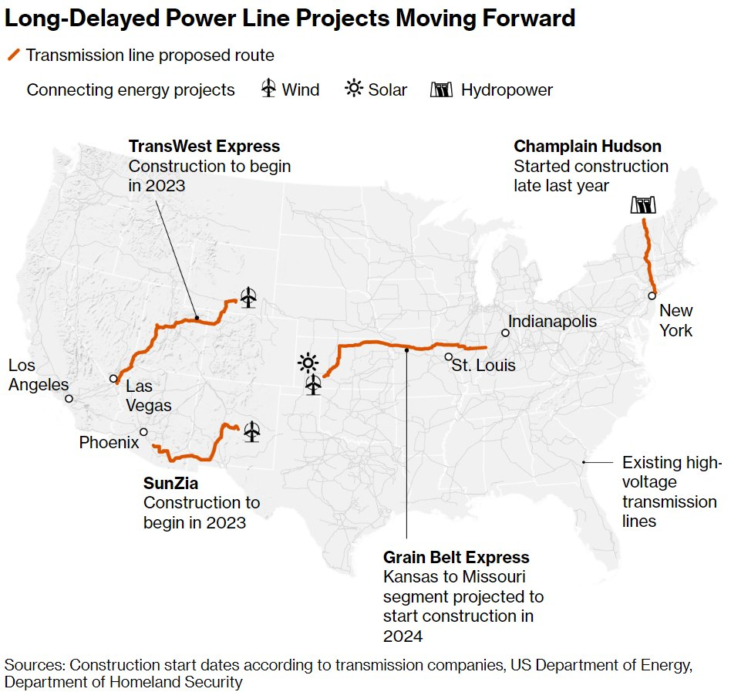
Major lines recently advancing
Have permits
Have subscriptions or tariff cost recovery
Source: https://www.bloomberg.com/news/articles/2023-03-06/billion-dollar-power-lines-finally-inching-ahead-to-help-us-grids#xj4y7vzkg

Slide 13
Voluntary “market-based” transmission under-invests, both in theory and practice
Dr. William Hogan
Dr. Paul Joskow
“If there were no economies of scale and scope for transmission investment, electricity markets could follow the same competitive model for transmission where beneficiaries determine and pay for their own investments. Given the large economies of scale and scope, transmission is a natural monopoly and investment requires a central coordinator.”
“There are numerous reasons why we should not expect “the market” to produce transmission enhancements that meet reasonable economic and reliability goals. Indeed, proceeding under the assumption that, at the present time, “the market” will provide needed transmission network enhancements is the road to ruin. There is abundant evidence that market forces are drawing tens of thousands of megawatts of new generating capacity into the system. There is no evidence that market forces are drawing significant quantities of entrepreneurial investments in new transmission capacity.”

Slide 14
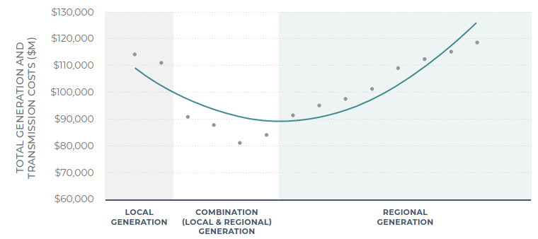
Economically sound transmission planning
“Just and reasonable" has to mean maximize net benefits
Any other decision rule raises costs to consumers
Not least cost of transmission but least cost of delivered energy (generation + transmission)
Not benefit/cost ratio
Hogan: “A forward-looking cost-benefit analysis provides the gold standard for ensuring that transmission investments are efficient.”
Overcome generator protectionism with strong independent planning
MISO
Co-optimize transmission and generation

Slide 15
Improving benefits assessment
For
planning decisions
cost allocation
Use same benefits assessment for cost allocation
All electricity system benefits
Upgrade and integrate capacity planning and production cost tools
Scenario based/probabilistic
Incorporate realistic transmission outages

Slide 16
Actions Needed
FERC:
Required regional and interregional planning, with cost allocation methodologies based on sound benefits assessment
Ensure appropriate deployment of grid-enhancing technologies, advanced conductors
PUCs
Transmission in IRPs
GETs and advanced conductors
Support and participate in regional planning and cost allocation
DOE + national labs
DOE lead agency for all federal permits
Designate corridors, consolidate steps (single NEPA)
Transmission needs and benefits analyses, develop and share tools
Congress
Bright line FERC plenary authority
Direct FERC re planning and cost allocation

