Slide 1

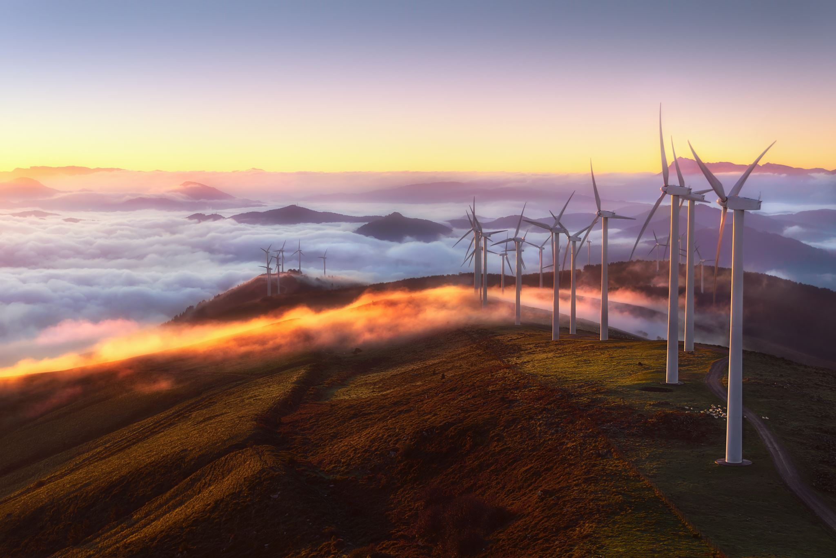
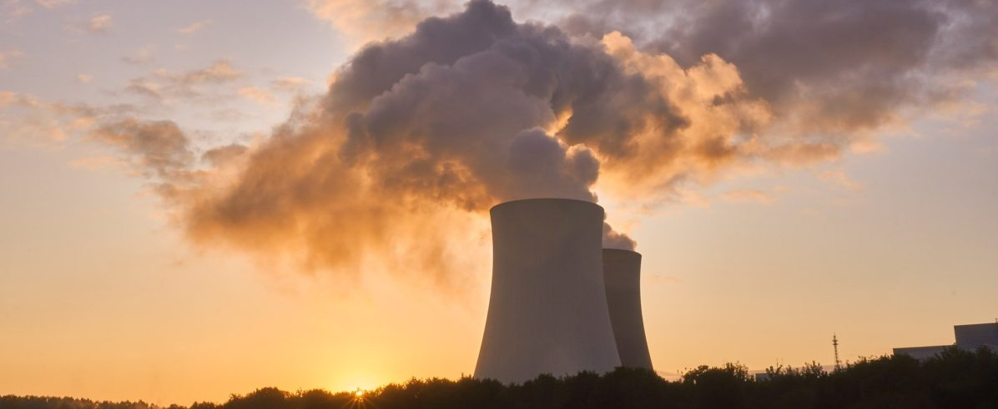



Energy System Impacts of the Inflation Reduction Act
Insights from EPRI’s US-REGEN Model
John Bistline (EPRI)
Coauthors: Geoff Blanford, Neil Mehrotra, Chris Roney, Catherine Wolfram, and David Young
Harvard Electricity Policy Group
May 31, 2023
www.epri.com
© 2023 Electric Power Research Institute, Inc. All rights reserved.

Slide 2
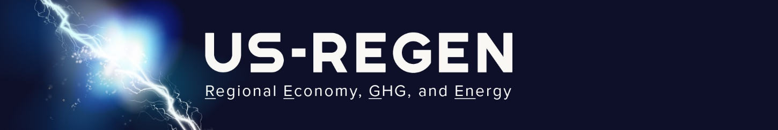




U.S. Regional Economy, GHG, and Energy (US-REGEN)
EPRI’s In-House Energy-Economic Model
Electric Generation
Energy Use
Integrated
Hourly Load, Renewables, and Prices
Model Outputs:
Generation, capacity, and end-use mix
Power sector and economy emissions
Detailed representation of:
Energy and capacity requirements
Renewable integration, transmission, storage
State-level policies and constraints
Detailed representation of:
Customer differences across end-use sectors
End-use technology trade-offs
Electrification and efficiency opportunities
Documentation, articles, and reports available at https://esca.epri.com

Slide 3
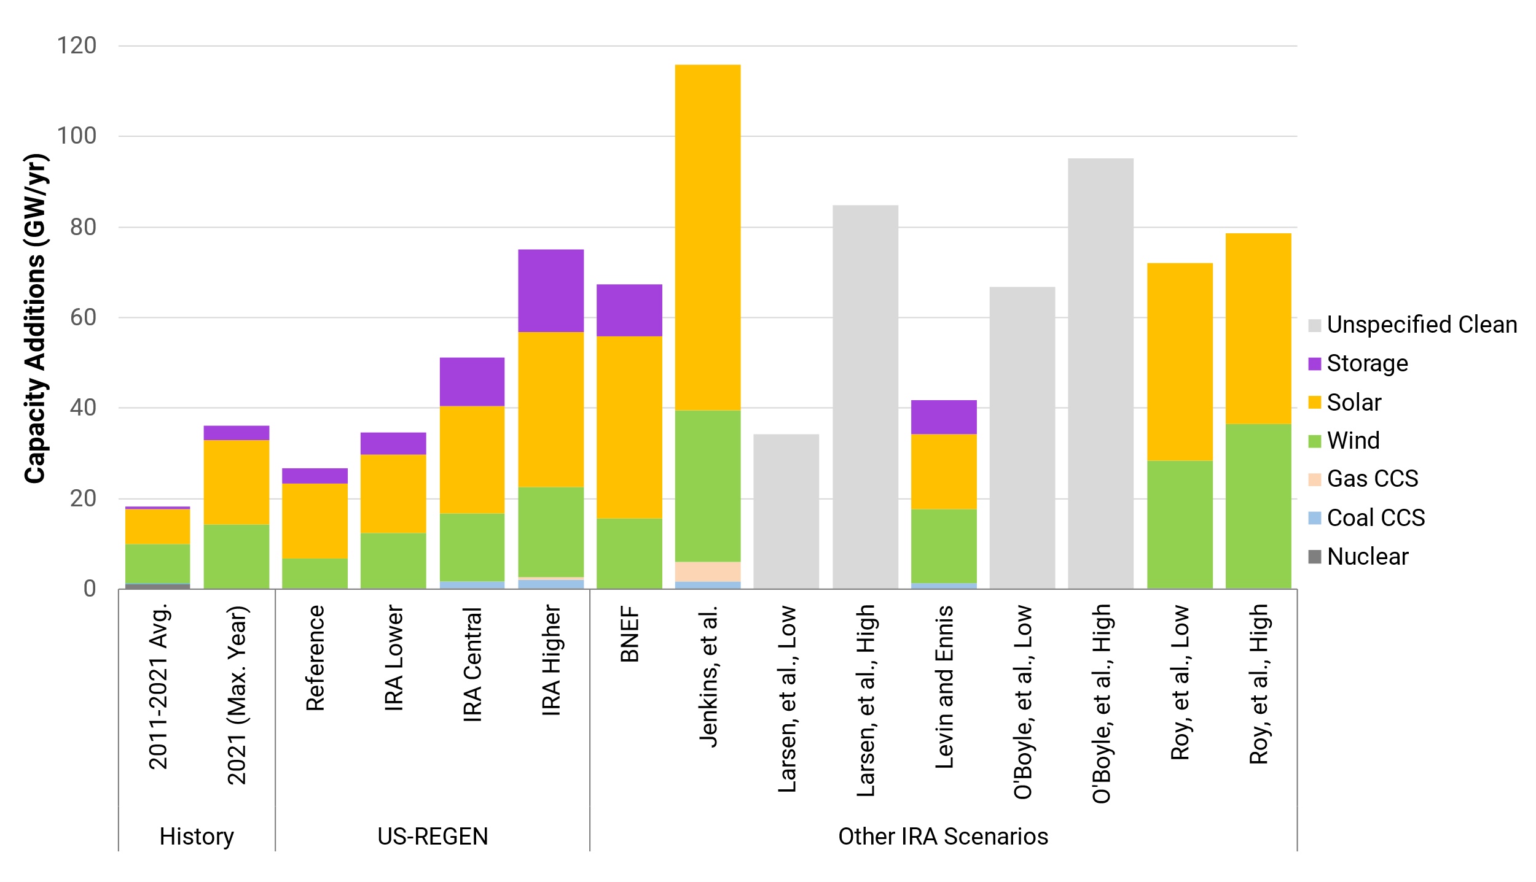
Rapid Buildout of the Grid in All Scenarios
Additions near historical maximum each year through 2030 with incentives
Source: Bistline, Mehrotra, Wolfram (2023), “Economic Implications of the Climate Provisions of the Inflation Reduction Act” (link)

Slide 4
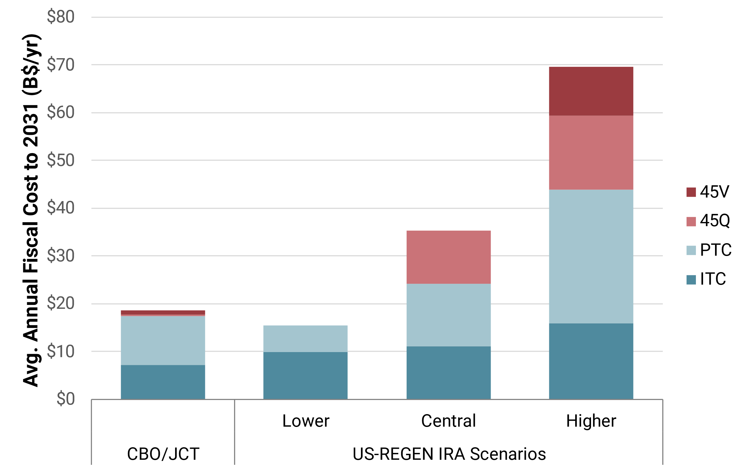
Annual Fiscal Costs of IRA Power Sector Credits in Context
2x Disney’s annual
content budget
Similar to Disney’s
content budget in
2022 (~$33 B)
Similar to U.S. almond
revenues (~$12 B)

Slide 5
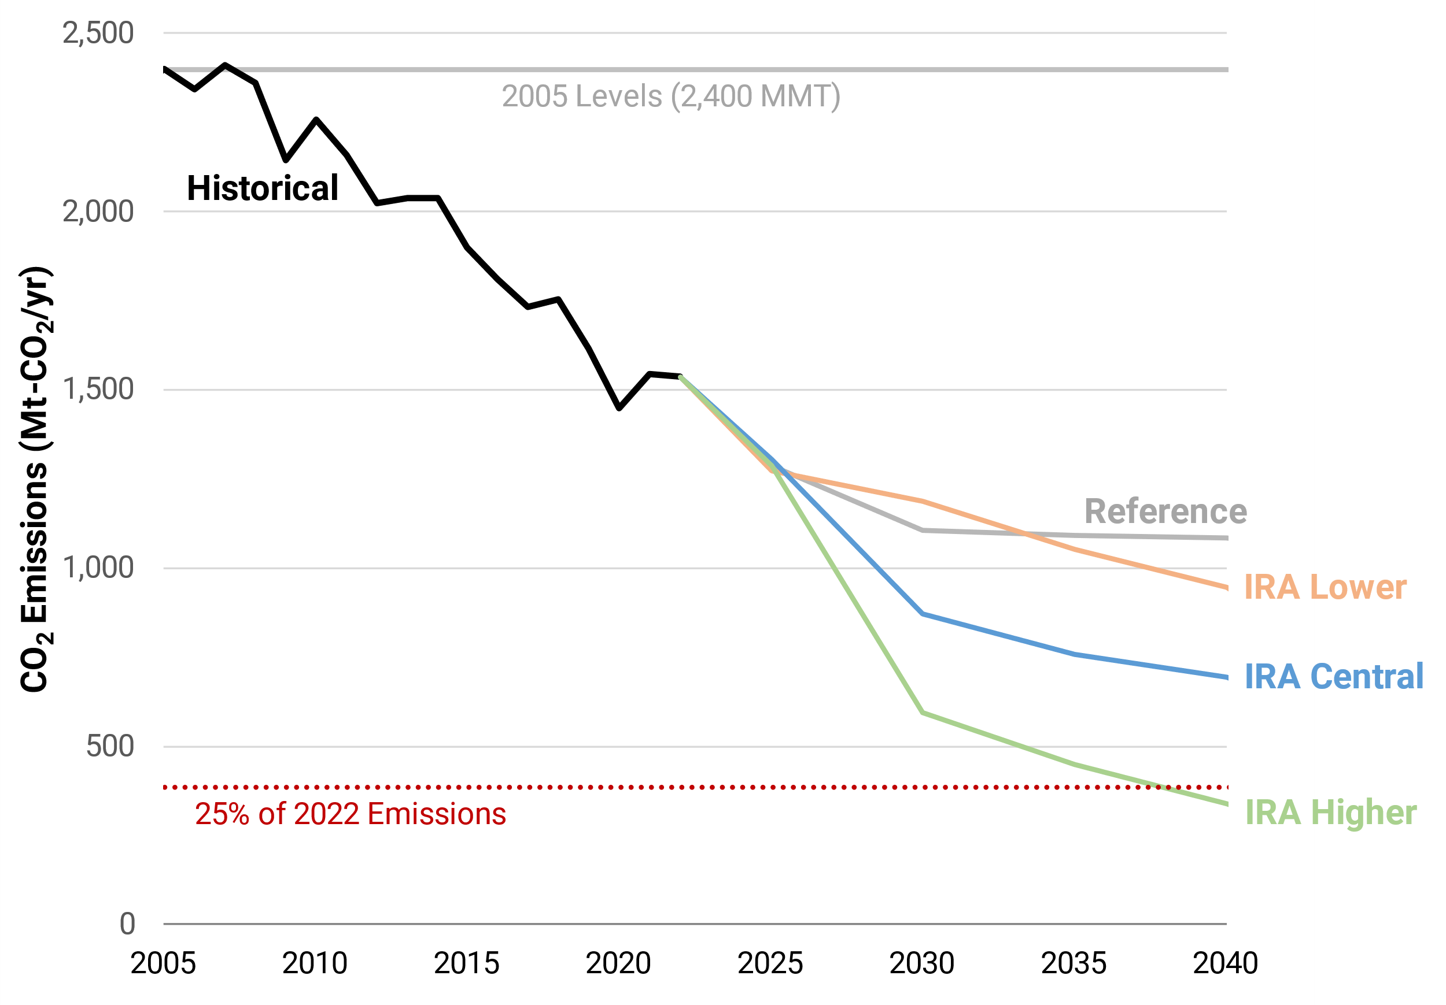
Historical and Projected Power Sector CO₂ Emissions
IRA reductions align with historical trends
PTC/ITC in place until power sector emissions reach 25% of their 2022 emissions
  Roughly 80% below 2005 levels
  Threshold reached after 2040 in many IRA scenarios
Source: Bistline, Mehrotra, Wolfram (2023), “Economic Implications of the Climate Provisions of the Inflation Reduction Act” (link)

Slide 6
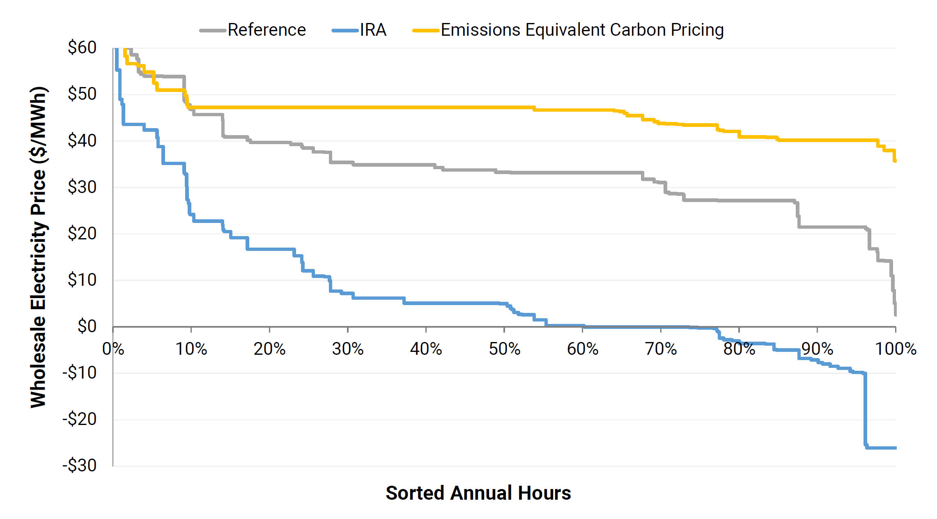
Policy Design Shapes Power Sector Outcomes
2050 Wholesale Electricity Price Duration Curve in SPP Region
Subsidies could increase frequency of negative wholesale prices, even while retail declines are modest
Source: Bistline, Mehrotra, Wolfram (2023), “Economic Implications of the Climate Provisions of the Inflation Reduction Act” (link)

Slide 7
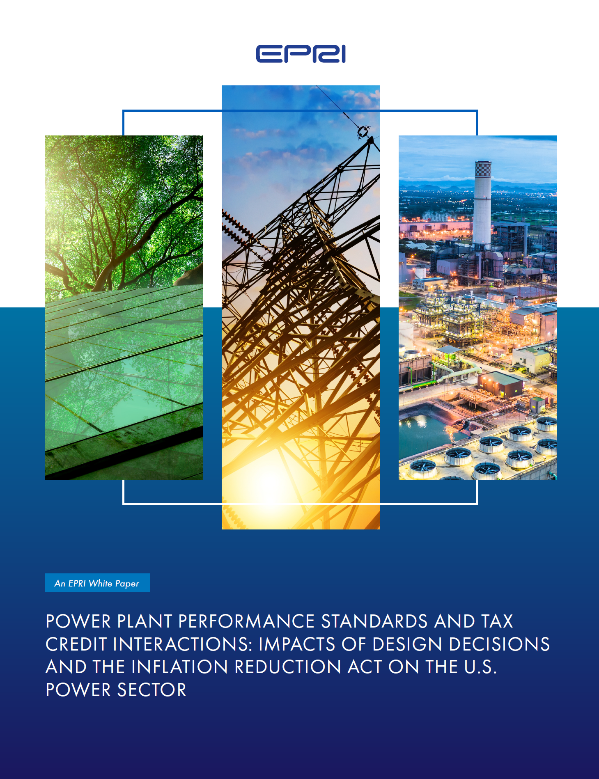
EPRI White Paper on 111 Performance Standards
Analysis of potential implications of new and existing source performance standards for the U.S. power sector
111(b) and (d)
Design Decisions
EPA released proposed rules in May under Clean Air Act 111(b) and (d)
Analysis examines how design decisions could impact investments, emissions, costs
Release of 111 white paper, which is free on epri.com to download (ID #3002026291)
April 4

Slide 8
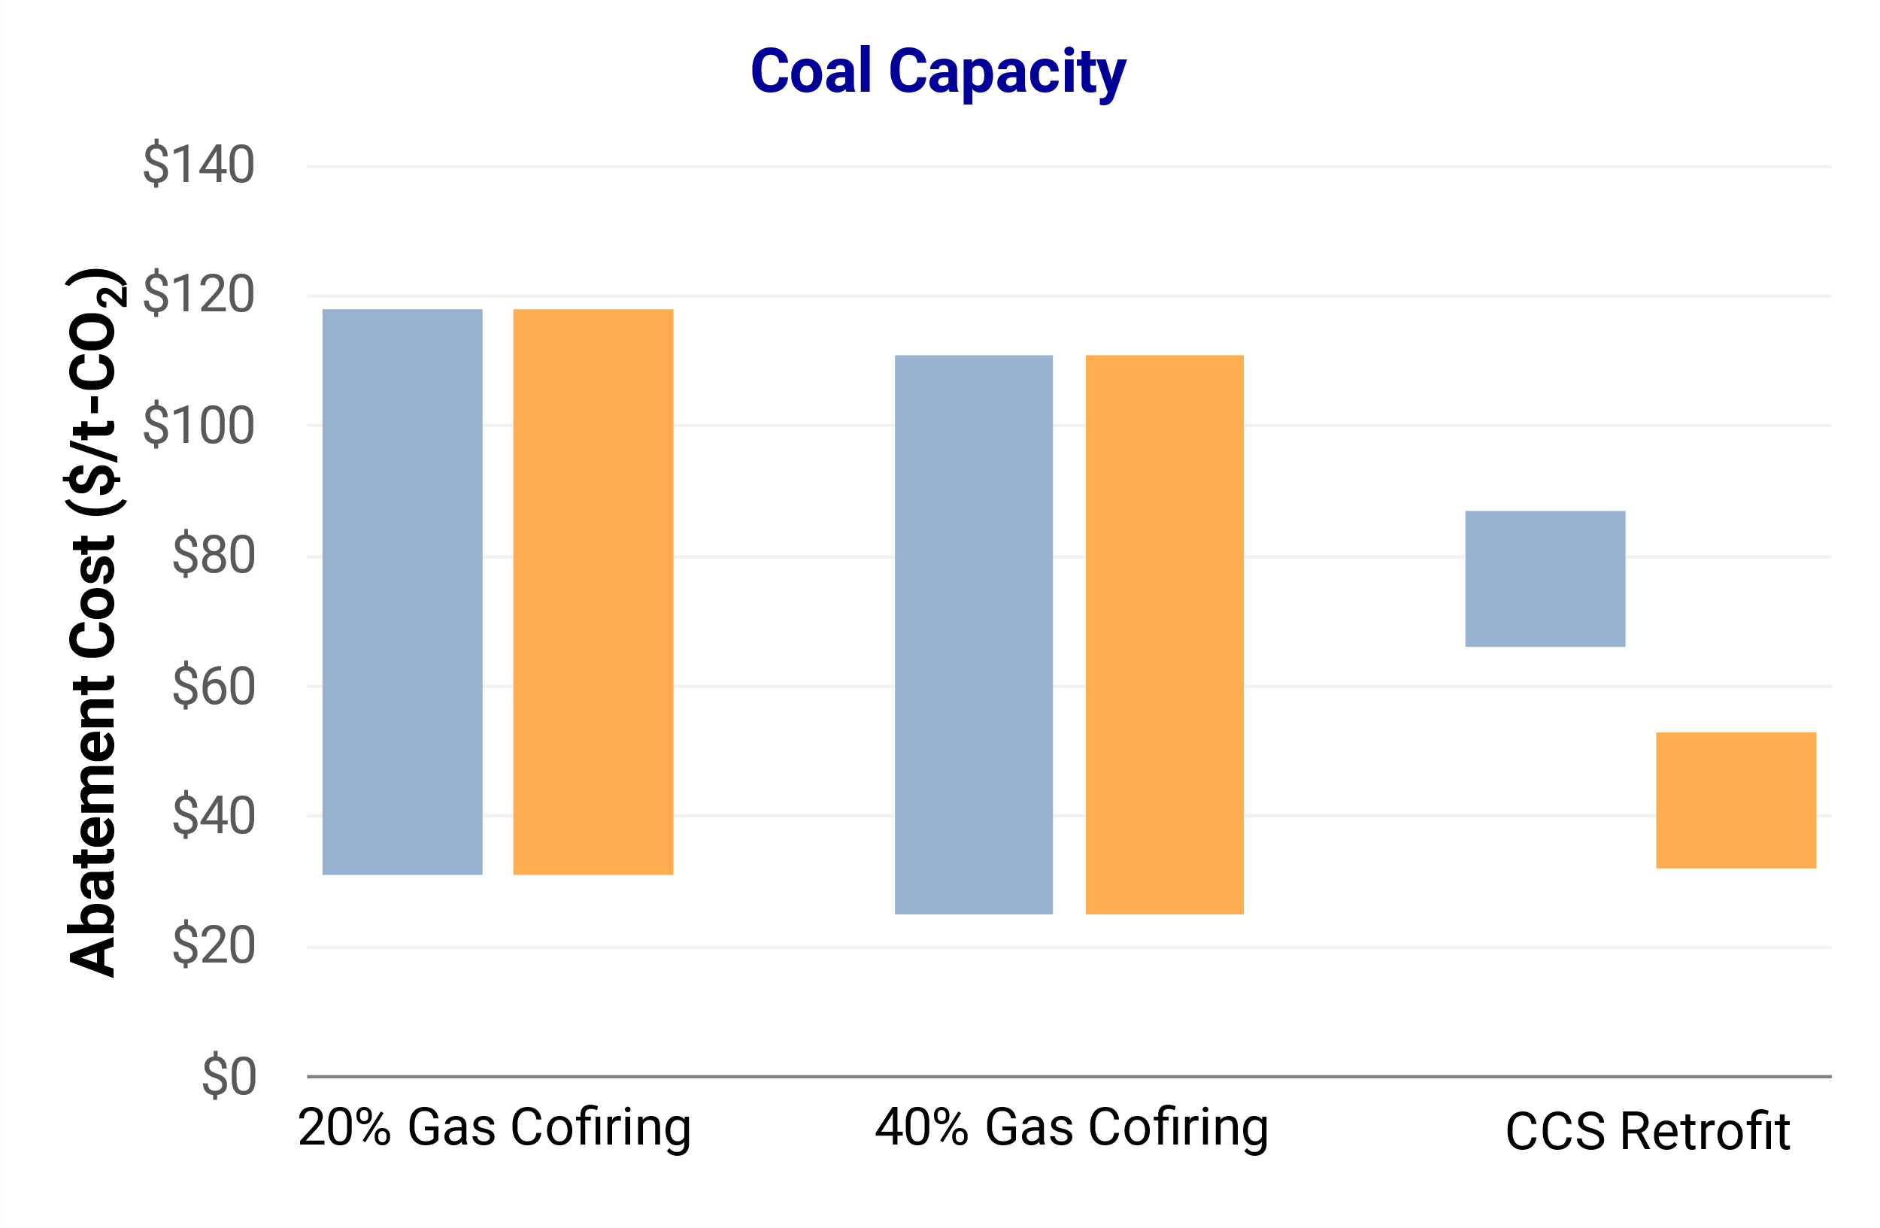
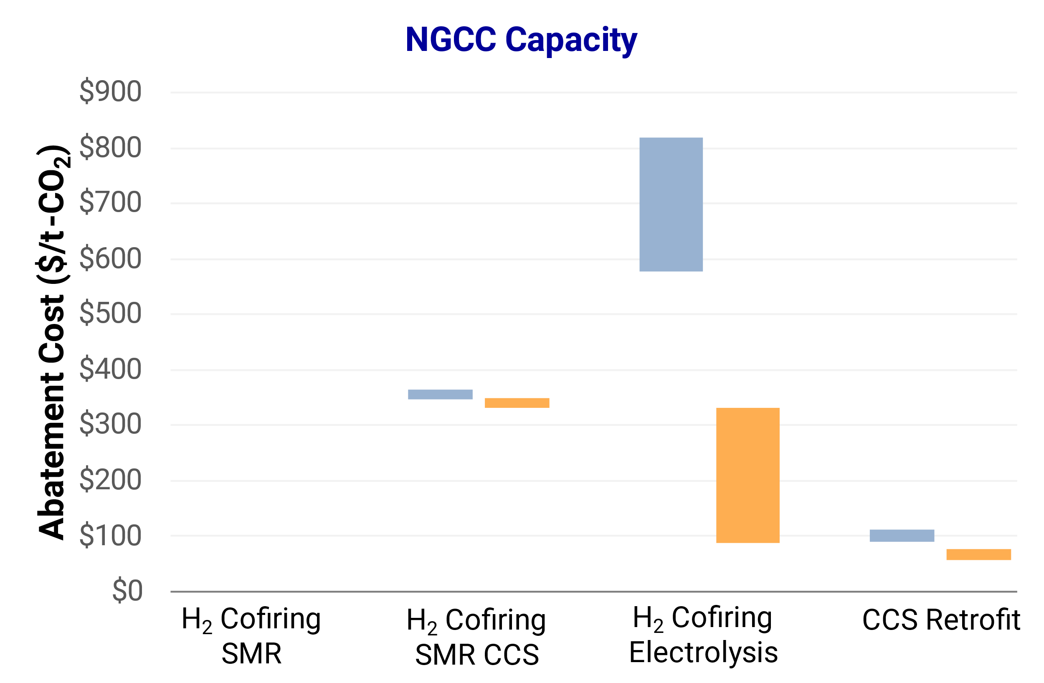
Illustrative Abatement Costs with 111(d) Options
Ref
IRA
Range reflects gas price $3-6/MMBtu
Range reflects capital costs from $2,800-3,900/kW
Range reflects gas price $3-6/MMBtu
Range reflects H₂ cost of $4-5.5/kg
(and 45V credits)
Range reflects capital costs from $1,250-1,800/kW
Marginal abatement costs can be order-of-magnitude higher for H₂ cofiring than gas cofiring at coal plants; IRA incentives are largest for coal CCS retrofits and electrolytic H₂ production

Slide 9
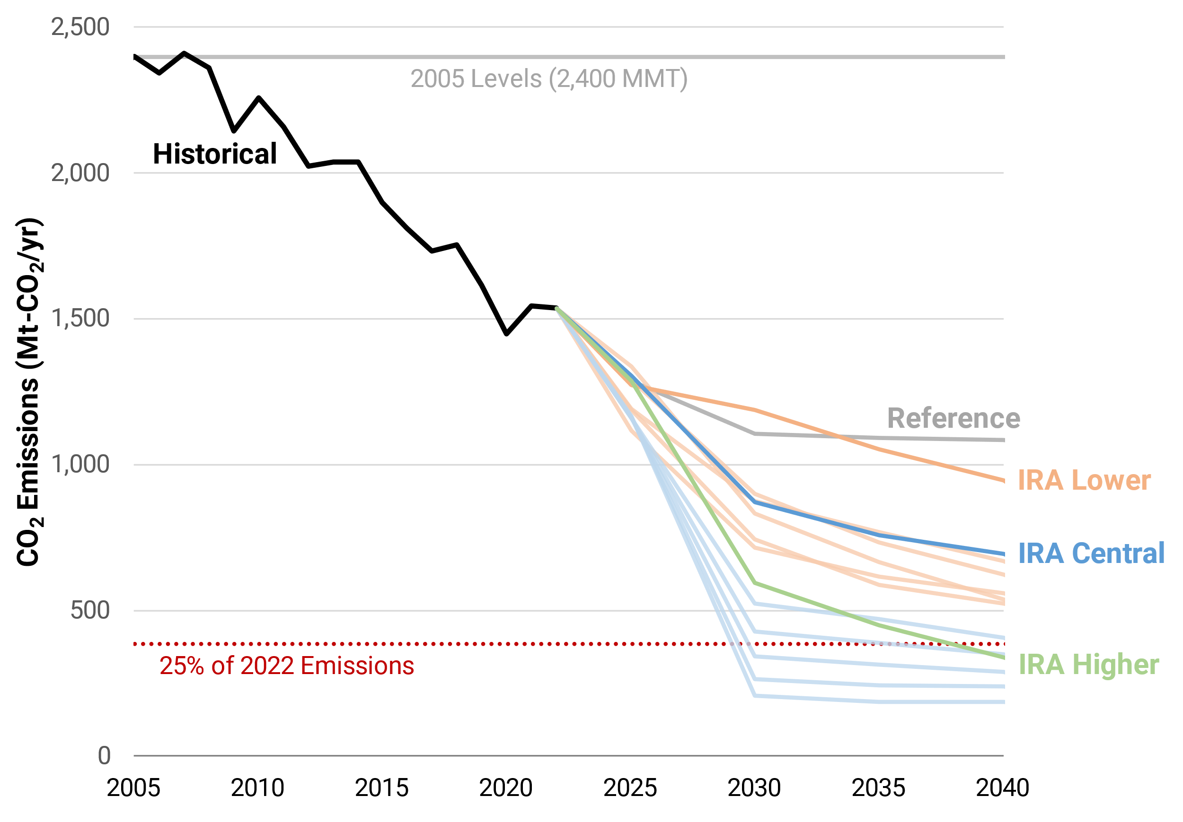
Power Sector CO₂ Emissions: IRA and 111 Standards
PTC/ITC in place until power sector emissions reach 25% of their 2022 emissions
  Roughly 80% below 2005 levels
  Threshold reached after 2040 in many IRA scenarios
Performance standard design decisions—esp. their trading provisions, form, stringency—materially alter outcomes
  Ranges reflect policy design
  CCS standards are considerably more costly than cofiring standards but achieve greater CO₂ reductions
Many caveats on deployment timelines, infrastructure, costs
111 Cofiring
Standards
111 CCS
Standards

Slide 10



Key Takeaways
IRA, along with other policies and market trends, shift “reference” scenarios away from natural gas and coal generation and toward low-CO₂ resources
  Coal declines faster than gas, and gas generation declines faster than gas capacity
  IRA continues to drive emissions reductions beyond 2030: Power sector CO₂ could fall ~60% below 2005 by 2030 and ~80% by 2035
111(d) design decisions alter CO₂, cost, and generation outcomes
  Flexibility (e.g., across plants and regions), form, and stringency are key
  CCS-based standards are significantly more costly than cofiring-based ones but lead to lower emissions
Modeling IRA impacts is challenging
  Many subjective modeling decisions, given IRA’s complexity and pending guidance
  Range of possible outcomes based on different interpretations
Many uncertainties moving forward about policy, market, and technological drivers will shape power sector trajectories

Slide 11
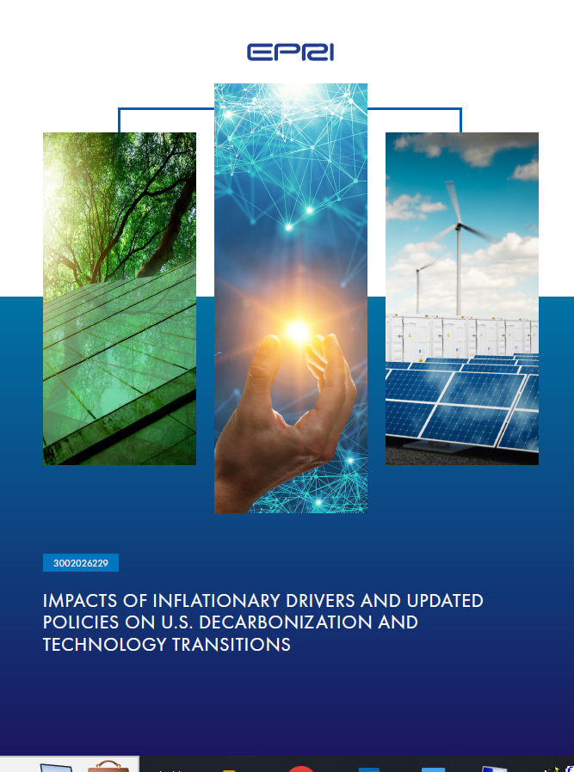

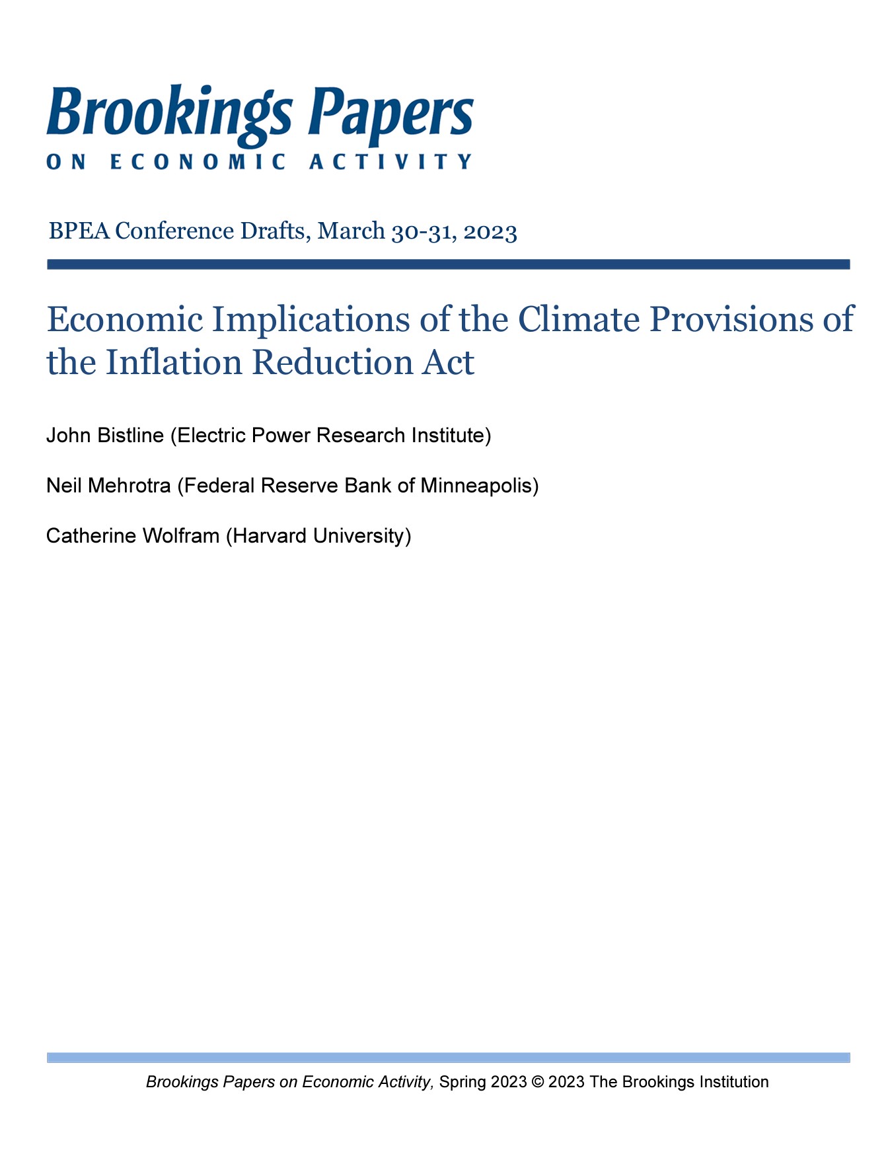
For More Information
Reports referenced in today’s presentation
Brookings IRA Analysis
Micro/macro economic implications of climate provisions of IRA (link)
111 Design Decisions
Near-Term Decarbonization Drivers
Analysis of implications of new and existing source performance standards for the U.S. power sector (link)
Impacts of IRA, 50x30 policies, and inflationary drivers (link)

Slide 13
Bibliography
Bistline, Mehrotra, Wolfram (2023), Economic Implications of the Climate Provisions of the Inflation Reduction Act, Brookings Papers on Economic Activity
Bistline, et al. (2022), Actions for Reducing U.S. Emissions at Least 50% by 2030, Science
Bistline, et al. (2022), Economy-Wide Evaluation of CO₂ and Air Quality Impacts of Electrification in the United States, Nature Communications
Bistline (2021), Roadmaps to Net-Zero Emissions Systems: Emerging Insights and Modeling Challenges, Joule
Bistline, et al. (2021), Deep Decarbonization Impacts on Electric Load Shapes and Peak Demand, Environmental Research Letters
Bistline, et al. (2021), Canadian National Electrification Assessment: Electrification Opportunities for Canada’s Energy Future, EPRI Report 3002021160
Blanford, et al. (2023), Net-Zero 2050: U.S. Economy-Wide Deep Decarbonization Scenario Analysis, EPRI Report 3002024882
Browning, et al. (2023), Net-Zero CO₂ by 2050 Scenarios for the United States in the Energy Modeling Forum 37 Study, Energy and Climate Change
For more information, see our website at https://esca.epri.com

Slide 14
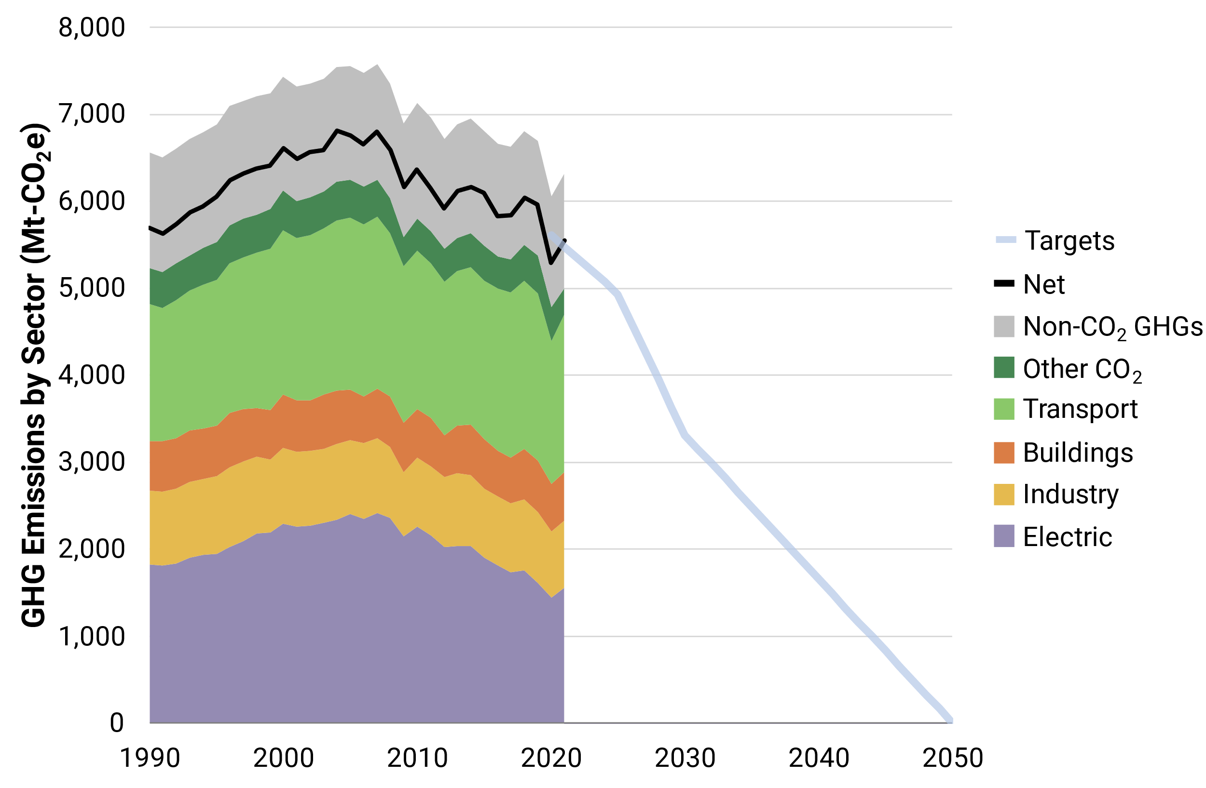
U.S. Greenhouse Gas Emissions and Future Targets
Energy CO₂ Emission Changes 2005–2021
  Electric 35%
  Industry 9%
  Transport 8%
  Buildings 5%
Non-CO₂ GHGs
2005
Non-Energy CO₂
2021
Transport
Buildings
2030
(U.S. NDC)
Industry
Electric
How would net-zero emissions be reached?
2050 Net Zero
Historical emissions from U.S. EPA’s “Inventory of U.S. Greenhouse Gas Emissions and Sinks”

Slide 15
Inflation Reduction Act (IRA) Modeled Provisions
Provisions shown next to applicable section
Electricity
13101: Production tax credit (PTC) extension
13102: Investment tax credit (ITC) extension
13103/13702: Solar in low-income communities
13015: Production tax credit for existing nuclear
13701/13702: New clean electricity PTC (45Y) and clean electricity ITC (48E)
Multi-Sector
13104: Extension of credits for captured CO₂ (45Q)
13204: Production credits for clean hydrogen (45V)
Transport
13401: Clean vehicle credit
13403: Commercial clean vehicle credit
13404: Alternative refueling property credit
Buildings
13302: Residential clean energy credit
13303: Energy efficient commercial building deduction
13304: Energy efficient home credit
50121: Home energy efficiency credit
50122: High efficiency home rebate program
Select Provisions Not Modeled
13201/13202: Extension of incentives for biofuels*
13203: Sustainable aviation credit*
13402: Credit for previously owned clean vehicles
13501: Extension of advanced energy project credit (48C)
45Q/45V limited outside of the power sector*
50161: Industrial facilities deployment program
Agricultural conservation and forestry
*Provisions we will be able to represent in LCRI model
Omission of provisions from modeling has ambiguous effects on emissions outcomes

Slide 16
Key Electric Sector IRA Provisions
Major Tax Credits with Electric Sector Implications
Clean Electricity Production Credit
Clean Electricity Investment Credit
CO₂ Capture & Storage Credit
Clean H₂ Production Credit
Up to ~$30/MWh (for 10 years), with complex bonus rules
Replaces existing credits for wind/solar starting in 2025 for all technologies with “emissions intensity not greater than zero”
IRA §13701
30% with labor bonus with 10 p.p. bonuses for domestic content and energy communities
Standalone storage is eligible (in addition to PTC-eligible technologies)
Like PTC, extends until power CO₂ is 25% of 2022 levels (or 2032)
IRA §13702
Up to $85/tCO₂ captured with bonus
12-year eligibility
Must begin construction by 2032
Projects cannot stack 45Q and other credits
Like 45V, no bonuses for domestic content/EC
IRA §13104
Depends on lifecycle GHG intensity of production, measured by ANL’s GREET model
Up to $3/kg with 10-year eligibility (must begin construction by 2032)
Can be “stacked” with 45Y or 48E for electrolytic hydrogen
IRA §13204
45Y
48E
45Q
45V
NB: All dollar figures here refer to 2022 dollars; bill includes adjustments for inflation in future years

Slide 17
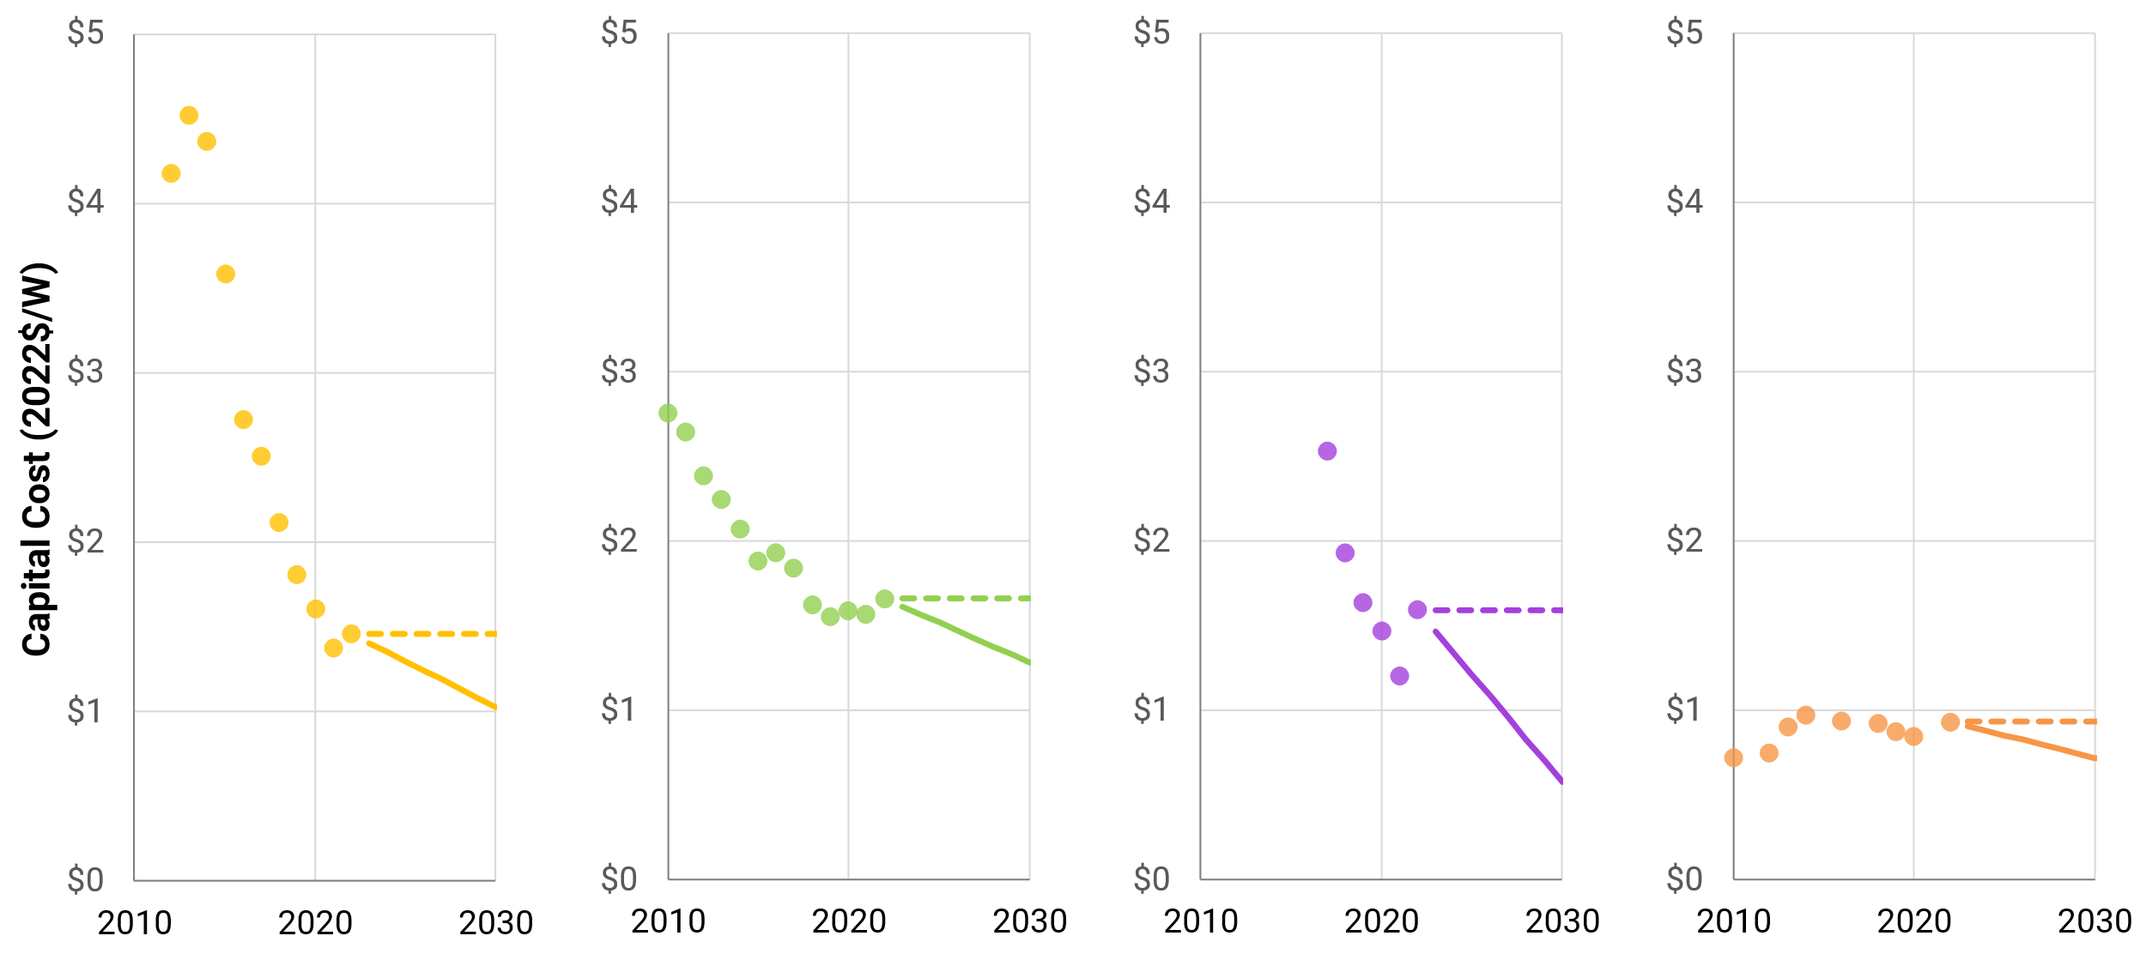
Cost Estimates for Generation/Storage Technologies
Solar PV
Onshore Wind
Battery (4-Hour)
NGCC
Present (2022)
Present (2022)
Present (2022)
Present (2022)
Higher Costs
Scenario
Lower Costs
Scenario
Sensitivities examine uncertainty about the persistence of near-term cost escalations
2022 estimates based on EPRI report 3002024231 (link)

Slide 18
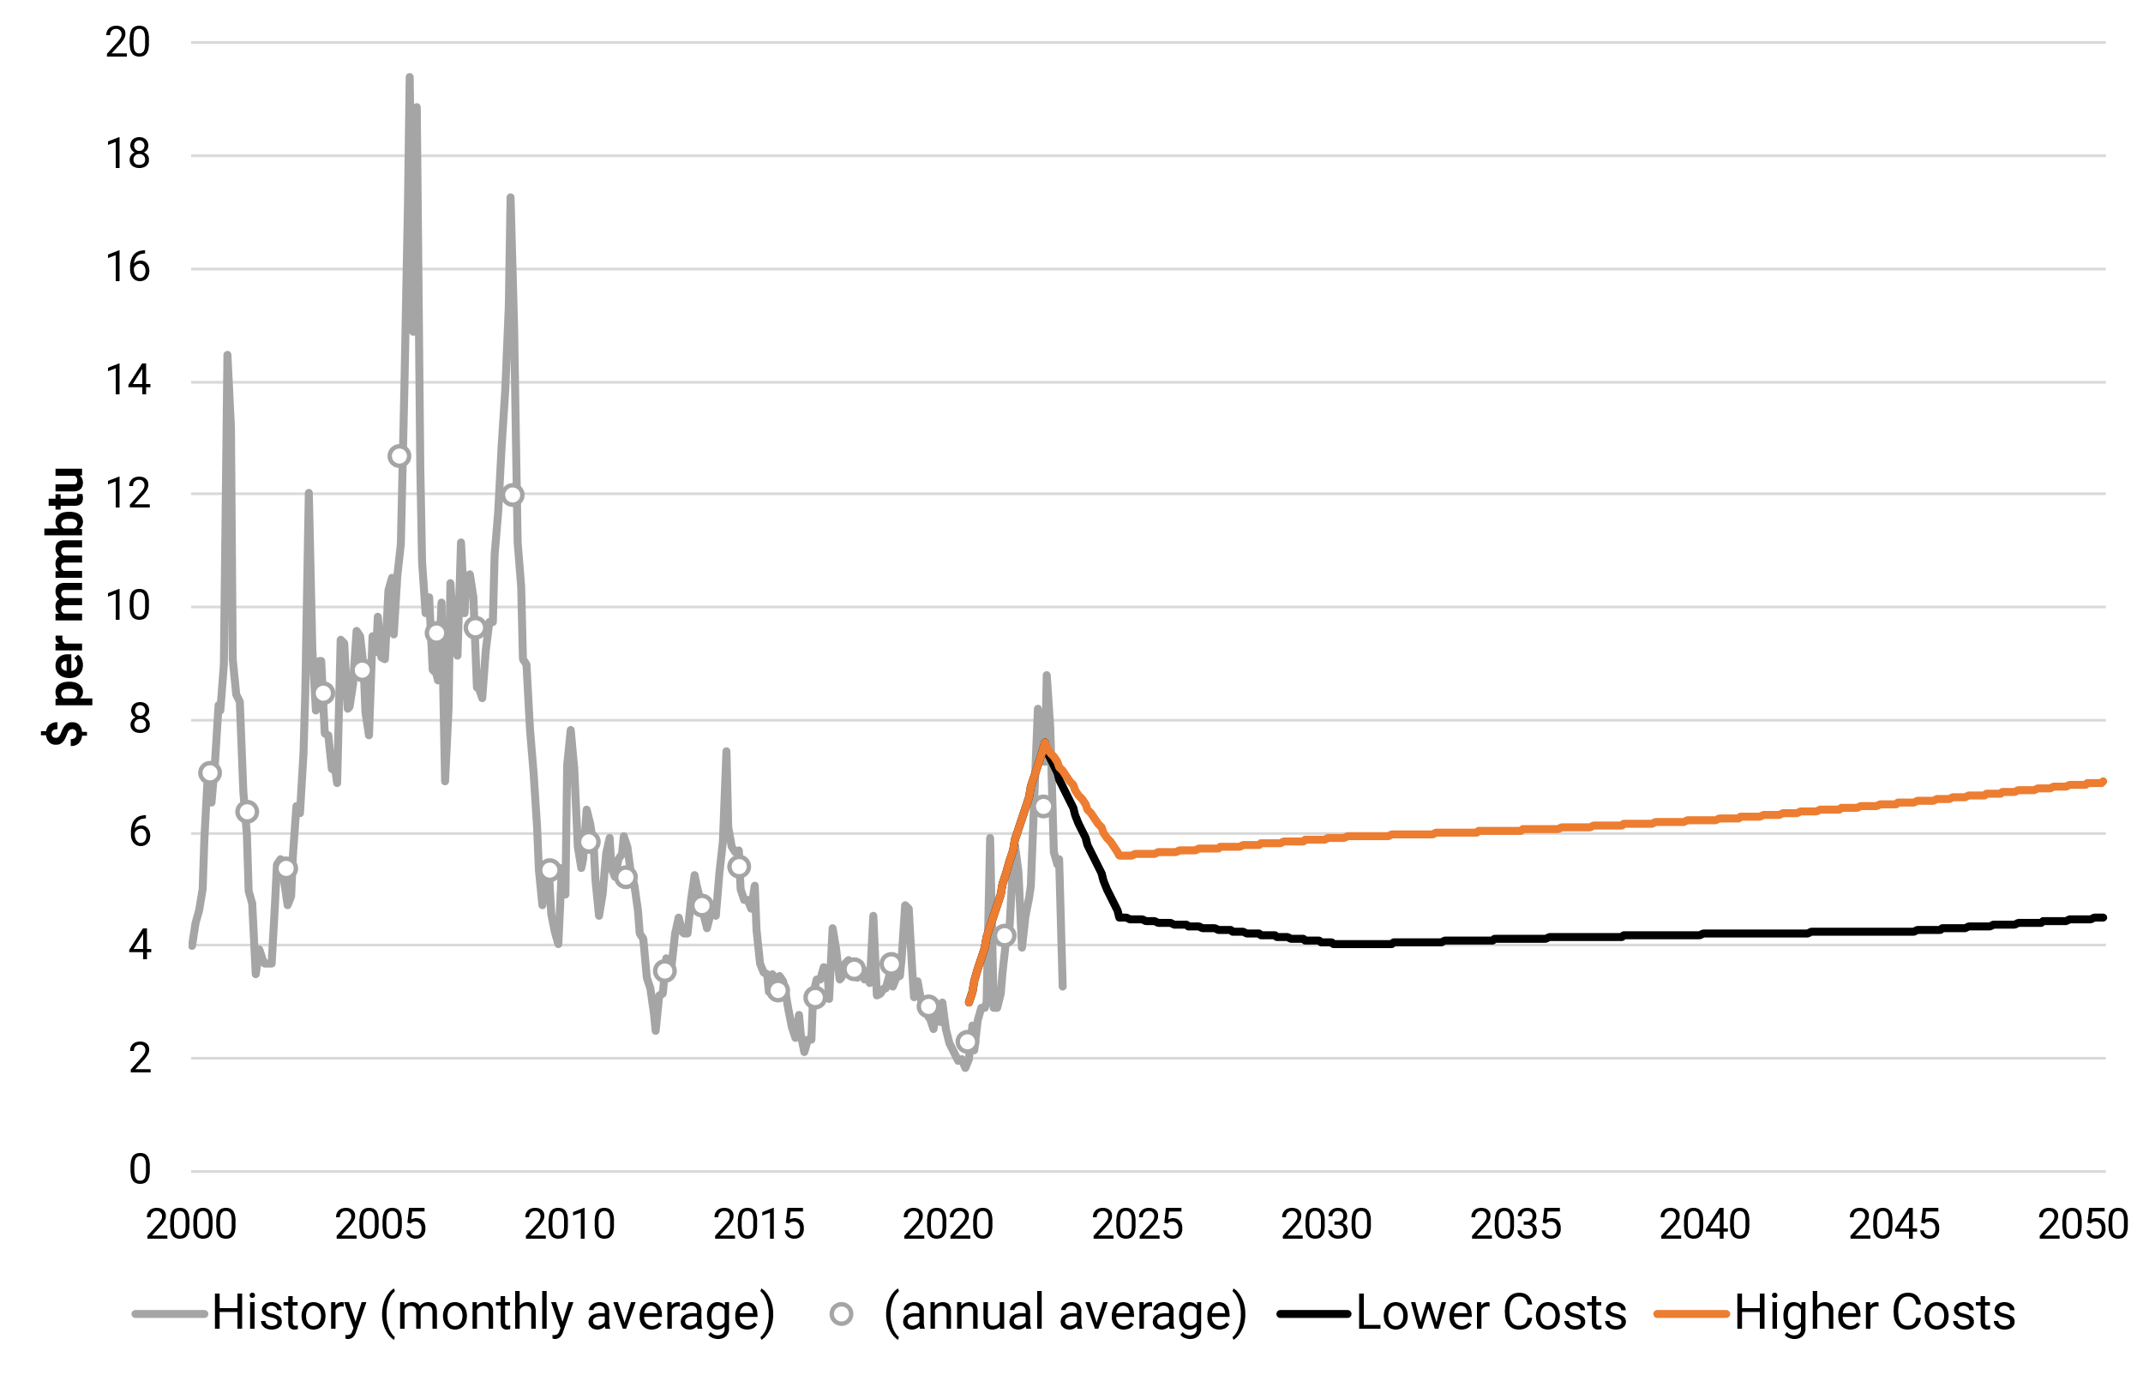
Natural Gas Price Scenarios
Prices in real 2022 U.S. dollar terms
Higher vs. Lower Costs (i.e., slow vs. fast recovery) scenarios span $2/MMBtu range by 2030

Slide 19
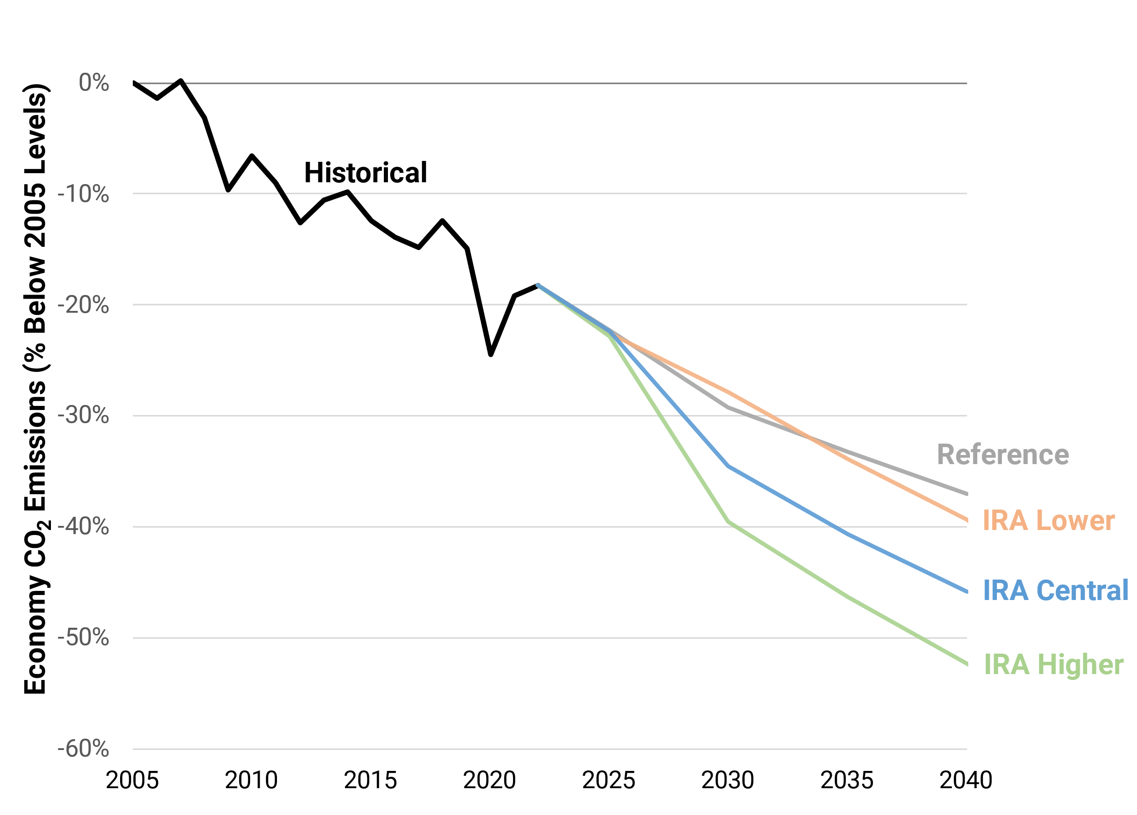
IRA Lowers Economy-Wide Emissions
IRA, combined with existing policies and technology trends, lowers CO₂ emissions, esp. from electricity and transport
  Range of reductions possible depending on implementation, additional policies, and macro context (interest rates, costs, etc.)
  Most of 2030 reductions under IRA come from power sector (70-74%)
Power sector leads additional reductions for 50x30 targets, similar to projections from the Science article on these targets
IRA helps to lower 2030 emissions, but additional reductions are needed from all sectors to meet 2030 targets; electricity plays a key role in direct and indirect reductions through electrification

Slide 20
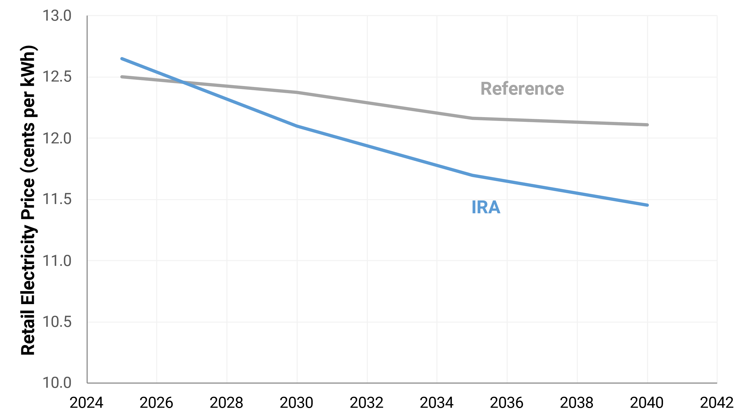
Retail Electricity Prices
Source: Bistline, Mehrotra, Wolfram (2023), “Economic Implications of the Climate Provisions of the Inflation Reduction Act” (link)

Slide 21
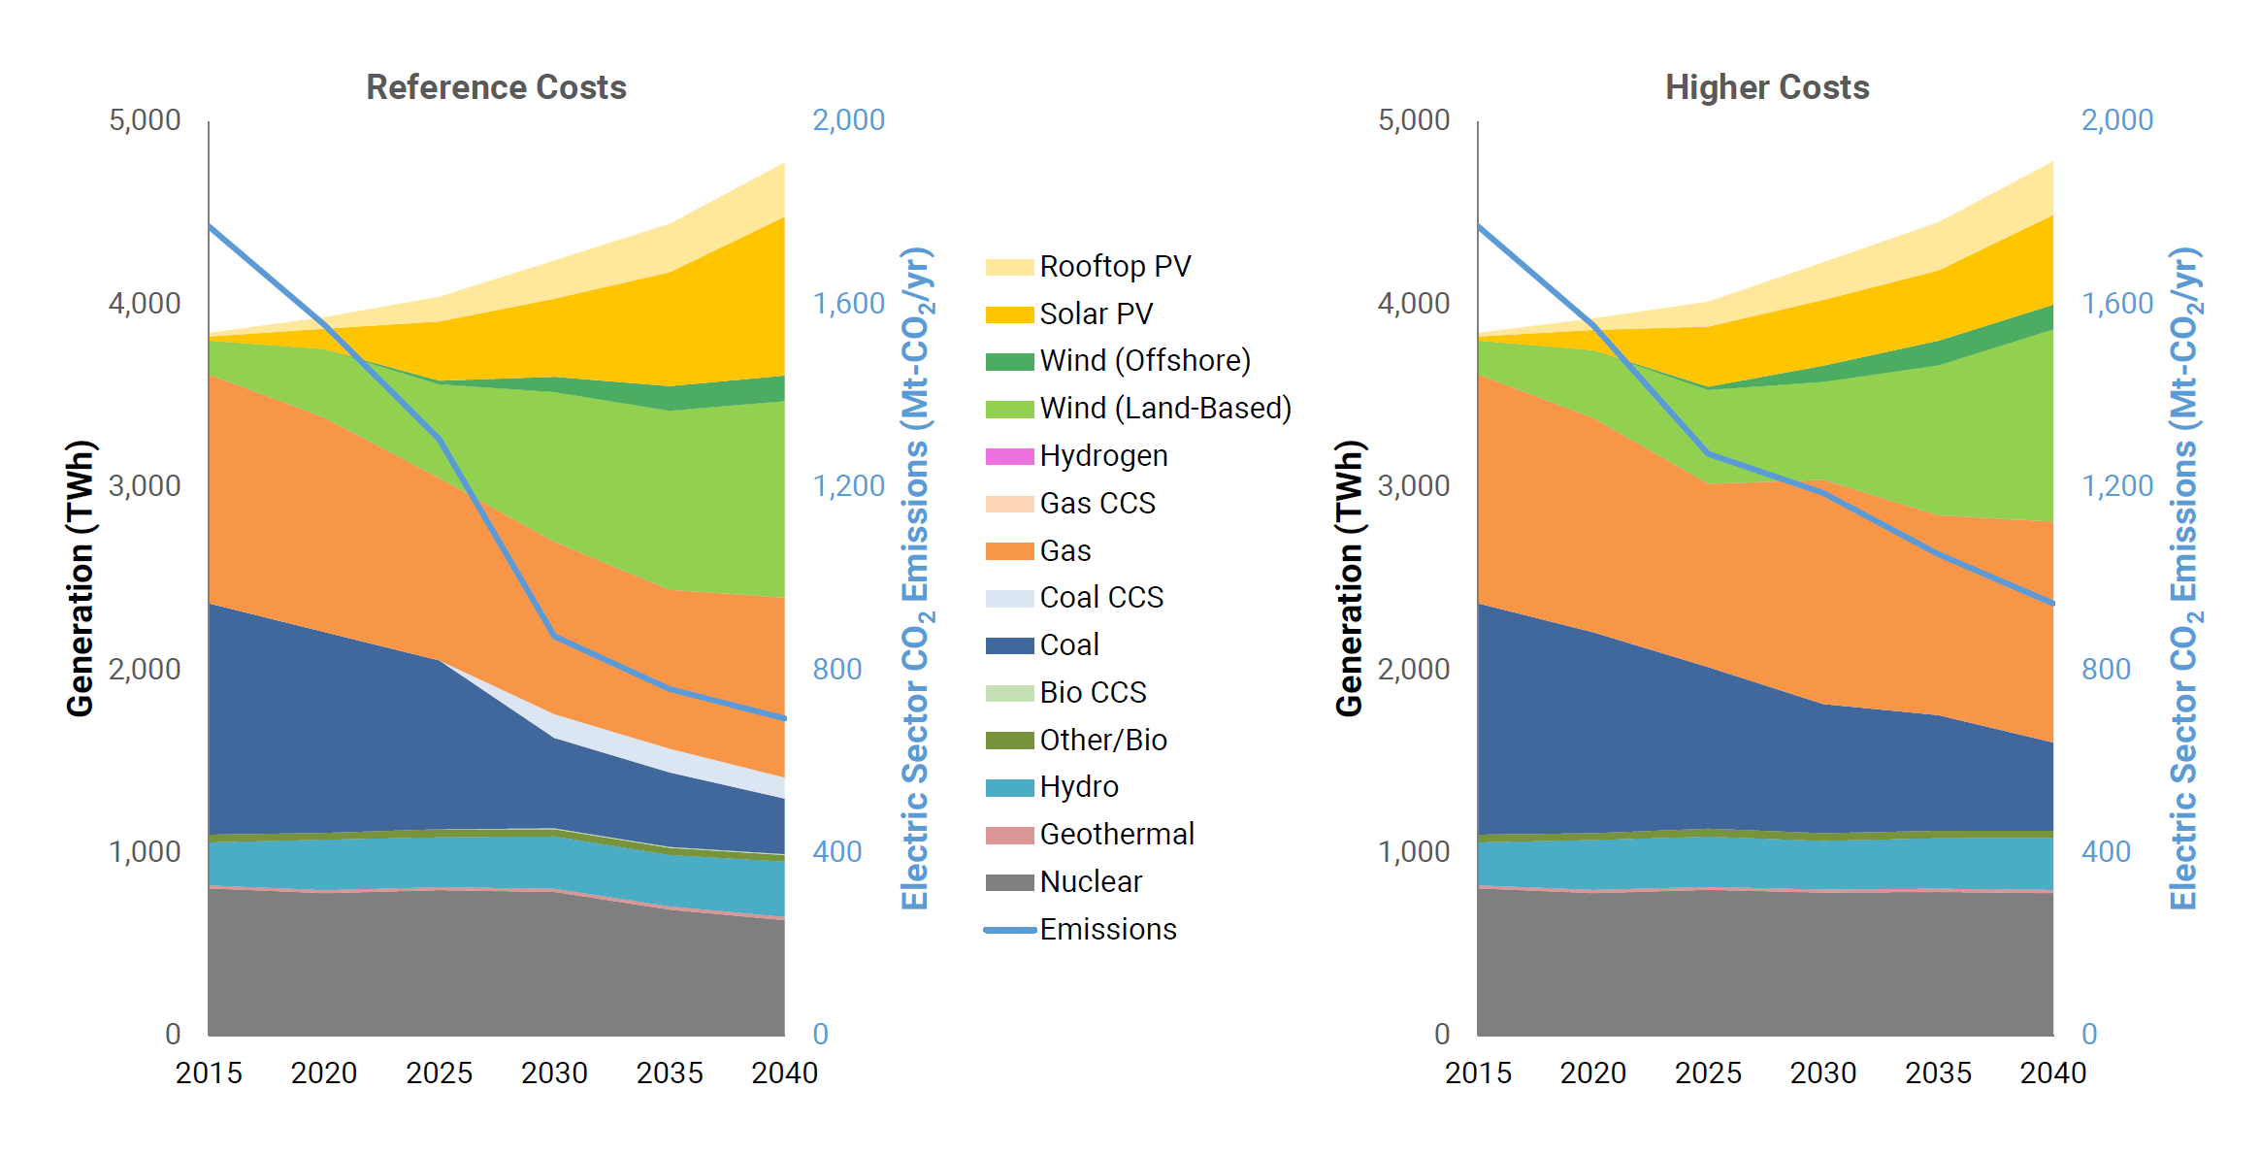
Electricity Generation

Slide 22
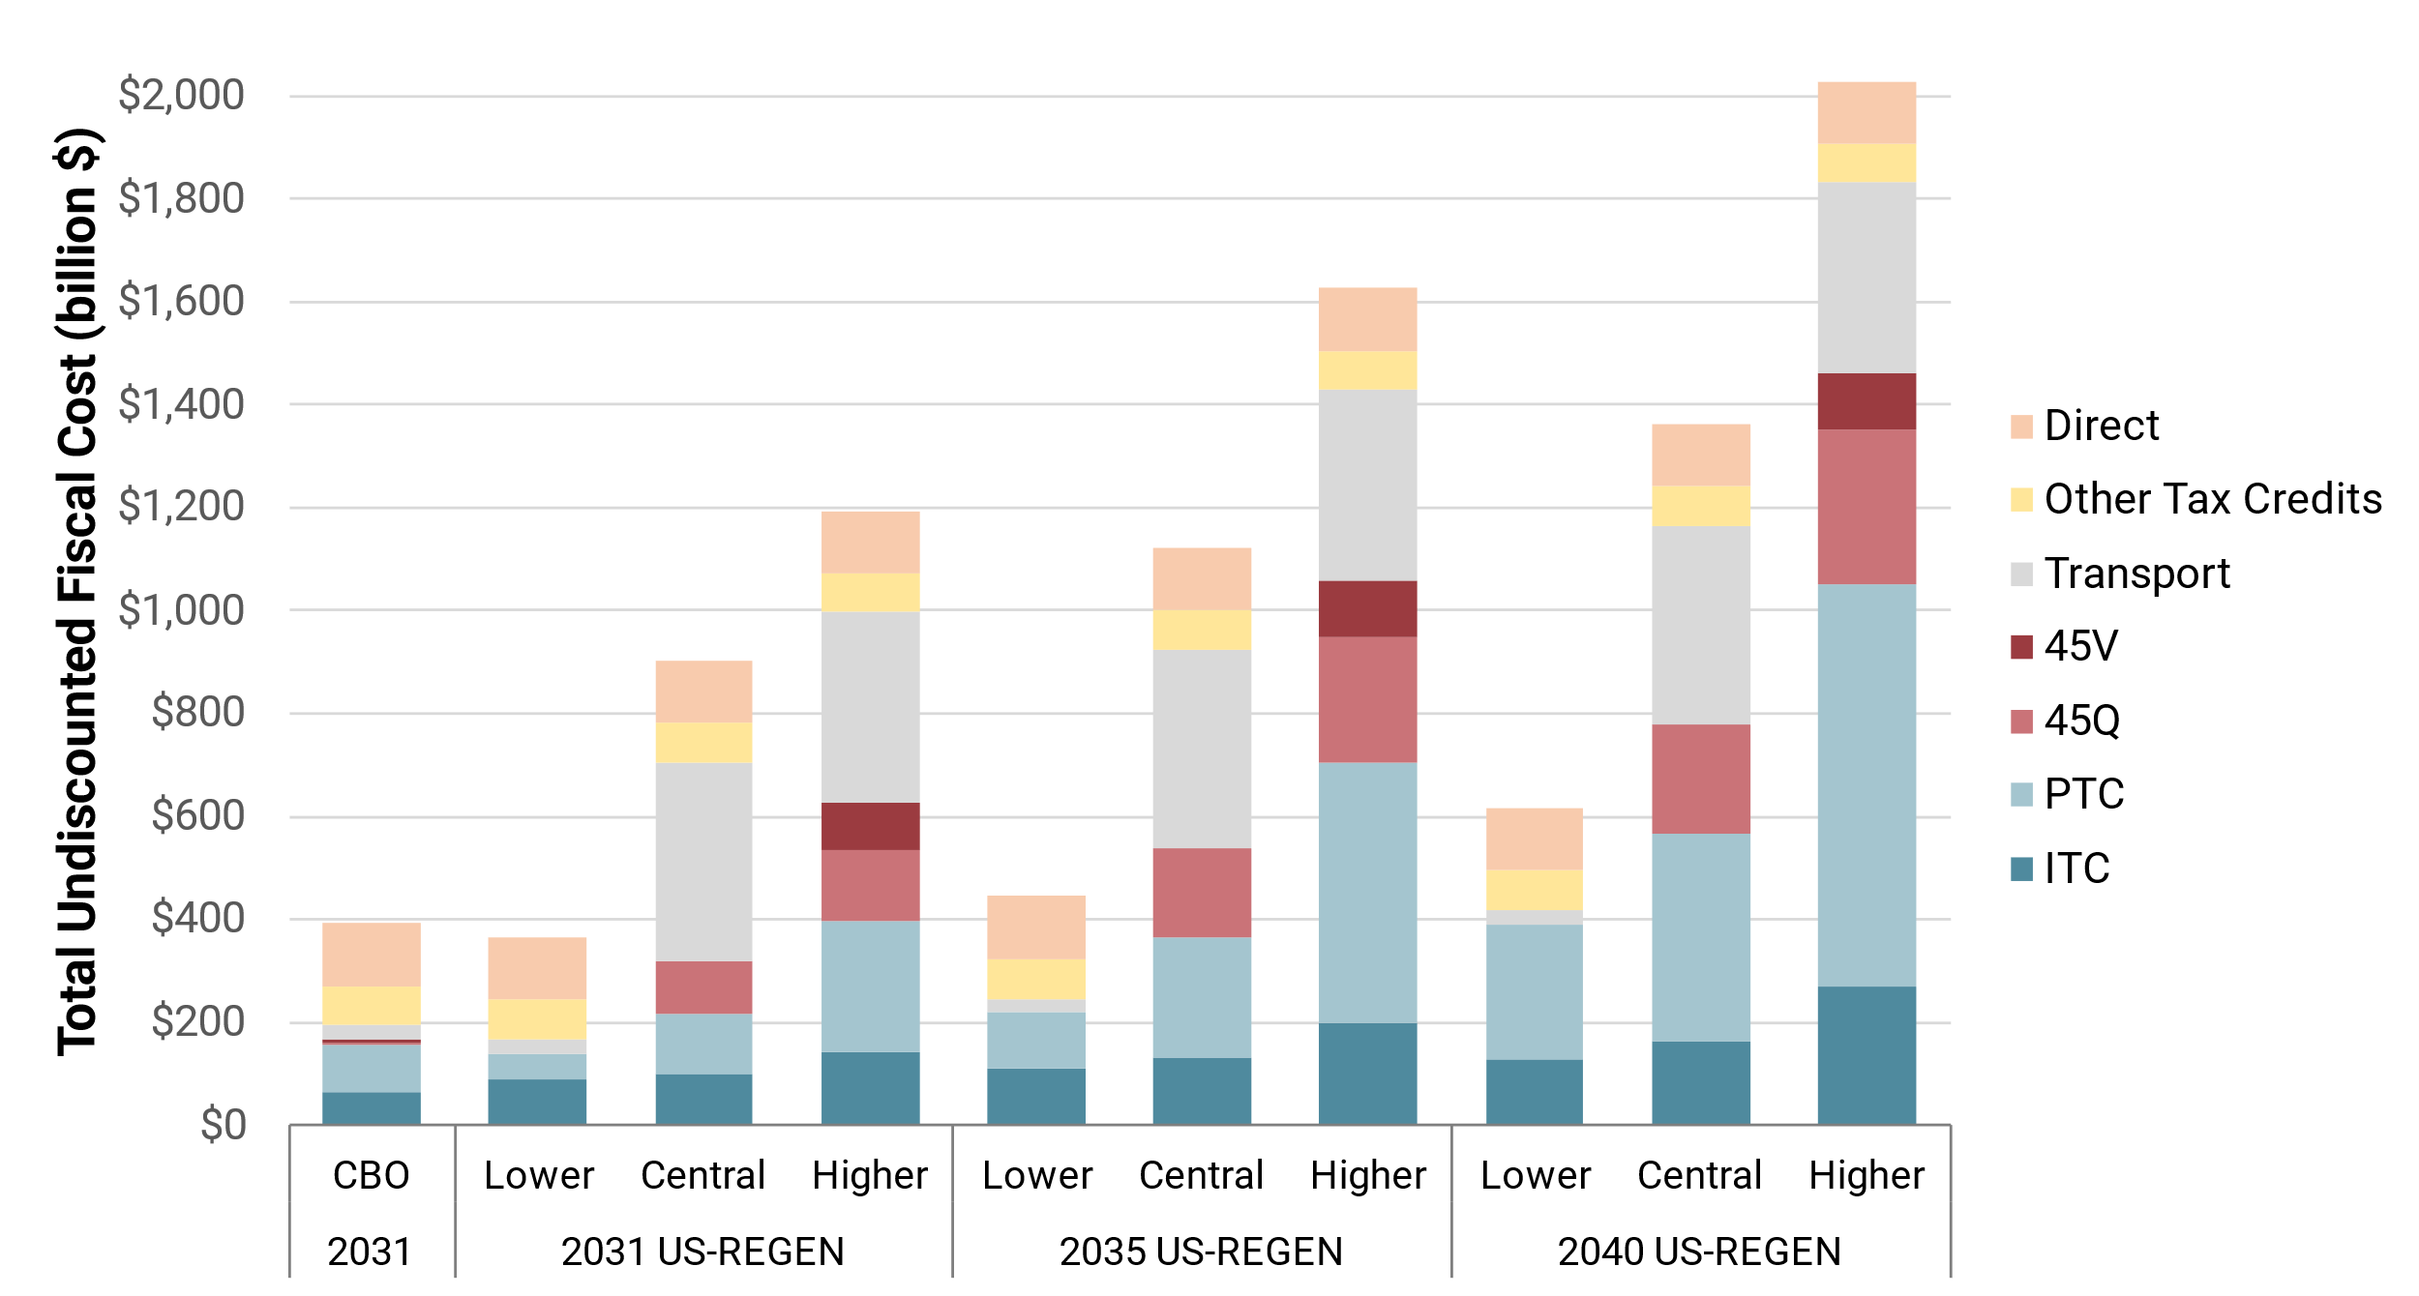
IRA’s Fiscal Costs and Abatement Costs
Fiscal costs through 2031 span wide range ($400-1,200 B)
  0.9 to 4x initial estimates due to higher clean energy deployment
  10-year fiscal costs align with Credit Suisse and Goldman Sachs ($800-1,200 B)
Average abatement costs range from $36-87/t-CO₂
  Discounted total resource costs divided by CO₂ reductions
  Reflects uncertain technologies, markets, and policies
Avg. abatement
Cost ($/t-CO₂)
$61-87/t-CO₂
$45-61/t-CO₂
$36-49/t-CO₂
Although fiscal costs are higher than initial estimates, average abatement costs are likely below social cost of CO₂ estimates, even before accounting for air quality co-benefits

Slide 23
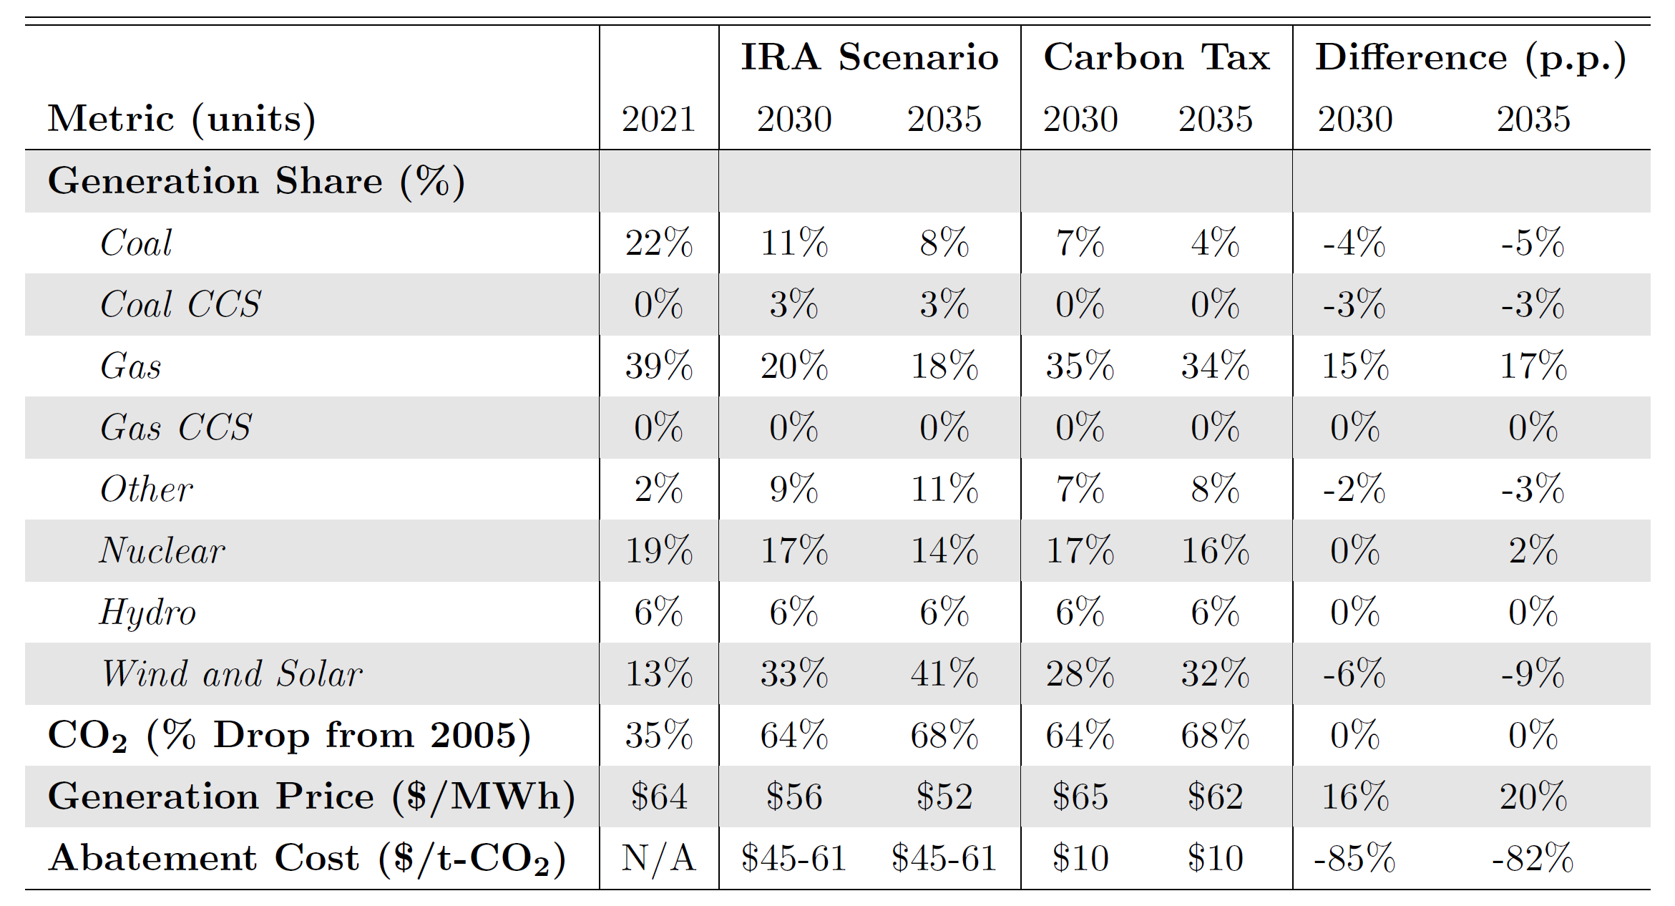
Policy Design Shapes Power Sector Outcomes
Comparing U.S. Inflation Reduction Act (IRA) subsidies vs. equivalent carbon tax
  Taxes have lower coal generation and lower abatement costs
  Subsidies have lower el. prices
IRA’s fiscal costs to 2032 span wide range ($400-1,200 B)
  0.9 to 4x initial estimates due to higher clean energy deployment
  Carbon tax would raise revenue
Policy design has first-order implications for resource investments, operations, cost, and emissions
Source: Bistline, Mehrotra, Wolfram (2023), “Economic Implications of the Climate Provisions of the Inflation Reduction Act” (link)

Slide 24
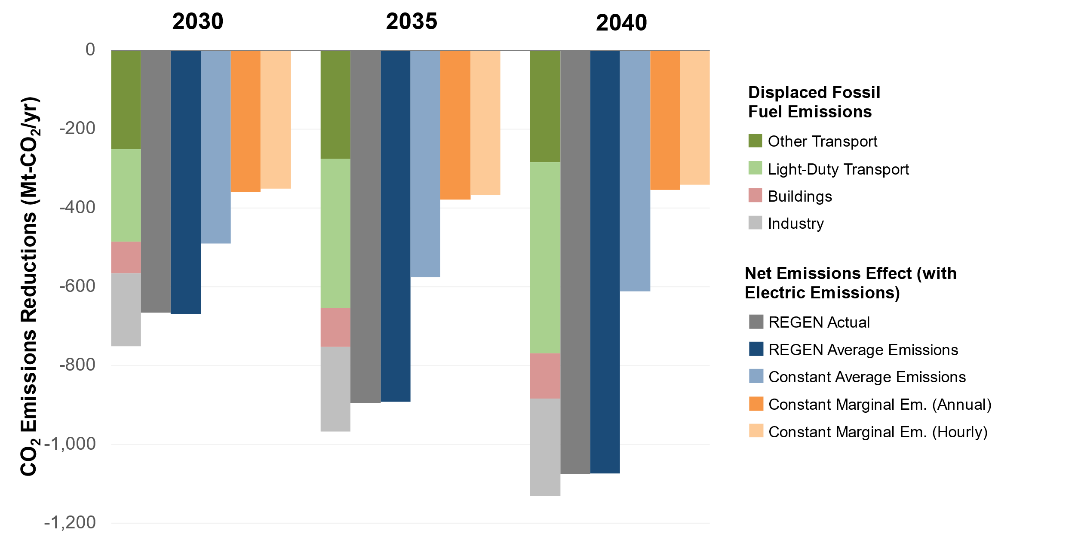
Appropriate Metrics for Measuring CO₂ Reductions?
Short-run marginal emissions approaches can underestimate CO₂ reductions from electrification by 32-91%
Source: Bistline, et al. (2022), “Economy-Wide Evaluation of CO₂ and Air Quality Impacts of Electrification in the United States” (link)

Slide 25
EPRI Publications on Reaching the 2030 U.S. Climate Target
Systems Modeling
Issue Deep Dives
Impacts of Inflationary Drivers and Updated Policies on U.S. Decarbonization (3002026229)
Free EPRI report available published in Mar. 2023
US-REGEN analysis 2030 targets and Inflation Reduction Act impacts
Wide range of “what-if” scenarios
Actions for Reducing U.S. Emissions at Least 50% by 2030
Published in Science in May 2022 (author link)
Multi-model comparison with authors and models from EDF (EDF-NEMS), EPRI (US-REGEN), LBNL (ReEDS + PLEXOS + FACT), MIT (USREP-ReEDS), PNNL (GCAM-USA-AP), NRDC (EnergyPATHWAYS + RIO)
Strategies and Actions for Achieving a 50% Reduction in U.S. Greenhouse Gas Emissions by 2030 (3002023165)
Free EPRI report available published in Nov. 2021
US-REGEN analysis of electric sector and economy-wide wide reductions
Enhancing Energy System Reliability and Resiliency in a Net-Zero Economy (3002023437)
Leveraging Existing Infrastructure: Increasing the Capacity of Transmission Lines (3002023004)
Technology Innovation: A Roadmap to Leverage Existing Nuclear Power Plants to Increase Zero-Carbon Energy Production (3002022700)
Electric Utility Workforce Development and Decarbonization (3002023229)
Maximizing Distributed Energy Resource Value Through Grid Modernization (3002023235)
Supply Chain Risks and Needs to Support Electric Utility Sector Decarbonization (3002023228)

